Slide 1
BAAR PCAS Agreements and Billing
BAAR Phase 3 Training

Slide 2
Welcome!
Notes:
Introduce instructor

Slide 3
Table of Contents
Segment 1: Project Cost Accounting System (PCAS) Overview
Segment 2: PCAS Agreements and Agreement Creation
Segment 3: PCAS Pre-Billing Transactions and Agreement Entity Updates
Segment 4: PCAS Unbilled Receivable Generation
Segment 5: PCAS Billed Receivable Generation
Segment 6: PCAS Accruals
Segment 7: Manual Credit Management
Segment 8: Billing-Related Collections
Segment 9: Receivable Management
Segment 10: Expiring Unfilled Customer Order Reversal
Segment 11: Mass Import
Segment 12: PCAS Reports

Slide 4
Segment 1:
Project Cost Accounting System (PCAS) Overview

Slide 5
Table of Contents
Segment 1: Project Cost Accounting System (PCAS) Overview
PCAS Overview and Key Concepts
PCAS Billing Process Overview
Segment 2: PCAS Agreements and Agreement Creation
Segment 3: PCAS Pre-Billing Transactions and Agreement Entity Updates
Segment 4: PCAS Unbilled Receivable Generation
Segment 5: PCAS Billed Receivable Generation
Segment 6: PCAS Accruals
Segment 7: Manual Credit Management
Segment 8: Billing-Related Collections
Segment 9: Receivable Management
Segment 10: Expiring Unfilled Customer Order Reversal
Segment 11: Mass Import
Segment 12: PCAS Reports

Slide 6
PCAS Overview and Key Concepts

Slide 7
PCAS Overview and Key Concepts
Pegasys Project Cost Accounting System (PCAS) module:
Provides for management of costs/revenues through use of “Agreements”
PCAS Agreement:
Define terms/conditions regarding the provision of goods/services by GSA to a customer
Record the amount of funding a customer agrees to provide to GSA in exchange for goods/services
Track fulfillment of customer orders by GSA for the customer
Agreements provide an automated means of:
Tracking spending for procurement of goods and services
Billing the customer for 1) expenses incurred or 2) a flat rate
Tracking customer reimbursements for goods/costs/services
PCAS (Agreement)
Costs (Spending/ Flat Rate)
Receivables (Billing)
Collections
CGI Federal Proprietary and Confidential

Slide 8
PCAS Lifecycle Overview
Agreement
Record Pre-Billing Transactions
Generate Receivable or Advance Offset
Agreement Interface
Manual Creation
Advances
Spending
Surcharges
PCPROJBILL
Track Receivable & Record Overdue Charges
Accruals
Send Bill to Customer
AROVERDUE
ARDUNNING
For “unbilled” spending at month-end
Credit Application
IPACOUT
ARBILLGEN
Record Collection
Disputes -
Chargebacks
Write off/ Adjustment/ Treasury Referral
IPACIN
LOCKBOX
Pay.Gov via CIR
Manual
IPACIN
Pay.gov via CIR
ARREFERSEL
ARTREOEX
AREOCOLL
IPACIN
Not all steps will apply to every Receivable. These are potential events in the Accounts Receivable Life Cycle.

Slide 9
PCAS Lifecycle Overview
The PCAS Lifecycle includes:
Creating Agreements in Pegasys (via Interface or Manually)
Record Pre-Billing Transactions
Collecting Advances and Security Deposits Received (when applicable)
Spending against Agreement (when applicable)
Assessing Surcharges as appropriate against Agreement
Generating Receivable and/or Advance Offset
Sending Bill to Customer/Sending Billing Data to Treasury
Recording Accruals (when applicable)
Tracking Receivable and Recording Overdue Charges
Recording Collections
Tracking and Managing Disputes and Chargebacks
Processing Write-offs / Adjustments / Treasury Refunds

Slide 10
Wave 3.3 and 3.4 Business Lines Using Agreements
Automated – PCAS Agreement generated in Pegasys via interface:
Note: AAS also uses PCAS Agreements generated in Pegasys via interface but follows the hybrid DBR/PCAS model and will be discussed in the DBR Billing course
Manual – PCAS Agreement generated in Pegasys via manual entry:
Business Line Name | Pegasys Business Line Value
Region 7:
Outlease | OUTLEASE
Business Line Name | Pegasys Business Line Value
Region 6:
Integrated Acquisition Environment (IAE) | R6MANUAL
Interagency Council (IAC) | R6MANUAL
Federal Citizen Services (FCS) | R6MANUAL
Great Seal of US | R6MANUAL
University For People (U for P) | R6MANUAL
External Services (USIP and Other Clients) | EXTSERVICE

Slide 11
PCAS Agreement Overview
PCAS Agreement – constitutes a written order from the customer requesting GSA to procure goods and services on its behalf
Pegasys Agreement Entity:
Tracks all Pegasys transaction referencing the Agreement
Provides detailed information for each transaction, including:
Advances, spending (i.e. costs incurred to fill customer order), surcharges, receivables, and collections
Established by processing a Pegasys Agreement Document
Pegasys Document Categories:
ED – External Direct Agreement for external customers
ID – Internal Direct Agreement for internal customers

Slide 12
PCAS Billing Process Overview

Slide 13
PCAS Billing (PCPROJBILL) Overview
PCPROJBILL determines if an Agreement is ready to bill based on:
Agreement Bill Frequency settings (defined on the Agreement line )
Agreement Bill Type settings (defined on the Agreement line)
Pre-billing transactions referencing the Agreement (when applicable) *
Once:
Agreement is Established
Pre-billing transactions are processed*
Surcharge Generation creates applicable surcharges*
…the revenue recognition transaction is then generated
*Depending on Agreement type/business line

Slide 14
PCAS Billing (PCPROJBILL) Overview
The following revenue recognition transactions are created by PCPROJBILL:
Billing Documents: Used to bill and credit external customers
GSA will initially create Billing Documents as “unbilled”
BD- Credit Line Type: Used to record credit amounts owed to customer
Advance Offset Cash Receipts: Used to offset Advance Payments
Record earned revenue associated with Advance Payment
Liquidate liability originally posted by Advance Payment
Utilize the Advance Offset Line Type
Internal Voucher: Used to record:
Expense for internal GSA customers (i.e. “the buyer”)
Revenue for GSA provider (i.e. “the seller”)

Slide 15
Billing Methods
Billing Method – defines:
Manner in which GSA initiates customer billing
Manner in which customer remits payment to GSA
GSA bills and receives customer payments via the following billing methods:
Standard Non-IPAC
Transaction between GSA and external Federal/non-Federal customer Customer actively initiates the remittance of payment to GSA via available payment methods NOTE: In some cases, Federal customers may remit payments via IPAC for non-IPAC bills
IPAC
Transaction between GSA and external Federal customer Billing and collection is performed via Treasury’s IPAC system Customer payment automatically received by GSA via IPAC Customer does not actively remit payment to GSA
Internal
Transaction between internal GSA business lines Intrafund: Billing within the same GSA Treasury Account Symbol (TAS) (e.g. 455 Fund billing 285 Fund) Interfund: Billing within GSA, but not within the same TAS (e.g. 285/455 paying rent to 192X)

Slide 16
PCAS Region 7 Outlease Example
An Outlease Agreement is created to document the terms and conditions of PBS renting office space within a PBS-owned building to an external non-Federal customer
Once the Agreement is established, the Agreement entity will track advance payments, advance offsets, receivables and collections via Pegasys transactions referencing the Agreement

Slide 17
PCAS Region 6 Manual Business Line Example
An Agreement may be created with an external customer when the University For People MBL hires an outside company to provide a training class for GSA
Once the Agreement is established, the Agreement entity will track spending (i.e. costs incurred to fill customer order), surcharges, receivables, and collections via Pegasys transactions referencing the Agreement

Slide 18
Segment 2:
PCAS Agreements and Agreement Creation

Slide 19
Table of Contents
Segment 1: Project Cost Accounting System (PCAS) Overview
Segment 2: PCAS Agreements and Agreement Creation
Agreement Attributes
Agreement Creation Overview
Agreement Document Overview
Agreement Entry Methods
Agreement Query
Segment 3: PCAS Pre-Billing Transactions and Agreement Entity Updates
Segment 4: PCAS Unbilled Receivable Generation
Segment 5: PCAS Billed Receivable Generation
Segment 6: PCAS Accruals
Segment 7: Manual Credit Management
Segment 8: Billing-Related Collections
Segment 9: Receivable Management

Slide 20
Agreement Attributes

Slide 21
Agreement Attributes
Customer Type
Internal
External
- Federal
- Non-Federal
Billing Method
IPAC
Standard/Non-IPAC
Interfund/Intrafund
Billing Model
Recurring
Spending-Based
Agreements in Pegasys can be categorized by various attributes, including:
Customer Type
Billing Method
Billing Model

Slide 22
Customer Type
External Direct Agreement
Used when GSA enters into an Agreement with an entity outside the agency (Federal, state, private company/individual)
Two types of transactions are used to record revenue for an External Direct Agreement:
Billing Documents
Advance Offsets (CR) if payment is funded by Advance Payment (CR)
GSA
DoD
California State Gov
EPA
…………………………………………………….......
GSA
PBS
OGP
OCSIT
FAS
Internal Direct Agreement
Used when GSA enters into an Agreement with another service/office/business line within GSA
Used to generate Internal Vouchers to simultaneously record expense for the buyer and revenue for the seller
CGI Federal Proprietary and Confidential

Slide 23
Customer Type – External: Federal vs. Non-Federal
Federal and Non-Federal External Agreements are distinguished via the Vendor Code referenced on the Agreement
Agreements
External
Federal
Non-Federal
Internal
Federal Agreement:
When an Agreement is established between GSA and a Federal customer, GSA can fill the customer order immediately
Federal customer Agreements do NOT require an Advance Collection
Non-Federal Agreement:
When an Agreement is established between GSA and a Non-Federal customer, GSA must wait for the customer to provide a monetary Advance before the customer order can be filled
Advance created as a Cash Receipt with an Advance Payment Line Type
Note: Advances for Outlease agreements are not required. A bill will be generated if advance is not received.
CGI Federal Proprietary and Confidential
Notes:
Examples of some of the larger Non-Federal clients GSA has: state governments and large metropolitan areas and key cities

Slide 24
Billing Methods
Billing Method by Customer Type:
External Agreements:
Federal:
IPAC or Standard (Non-IPAC)
Non-Federal:
Standard (Non-IPAC)
Internal Agreements:
Interfund/Intrafund
Agreements
External
Federal
Non-Federal
Internal
CGI Federal Proprietary and Confidential

Slide 25
Billing Methods
Pegasys provides multiple methods of billing out a Receivable:
Standard (Non-IPAC):
Standard (Non-IPAC) – transaction between GSA and customers in which the customer actively remits payment to GSA
NOTE: In some cases, Federal customers may remit payments via IPAC for non-IPAC bills
Intra-Governmental Payment and Collection (IPAC):
Transaction between GSA and customer agencies in which Billing and Collection is performed via Treasury’s IPAC system
Interfund/Intrafund:
Transaction between organizations within GSA
Intrafund – billing within the same Treasury Account Symbol (TAS) (e.g. 455 Fund billing 285 Fund)
Interfund – billing within GSA, but not with the same TAS (e.g. 285/455 paying rent to 192X)
Notes:
Interfund vs. Intrafund
Interfund transactions occur when one GSA Treasury Account Symbol (TAS) bills another GSA TAS (e.g. 285/455 paying rent to 192X)
All other Interfund transactions will be recorded using Internal Vouchers (NVs)
Intrafund transactions occur when the same GSA TAS bills itself
Intrafunds will be recorded using NVs

Slide 26
Billing Models
There are two types of Pegasys PCAS billing models:
Recurring – Pre-established Flat Rate per billing period
Spending-Based – Based on costs incurred referencing Agreement:
Actual Spending
Agreement Charges
Recurring and Spending-Based Agreements can be:
External Direct (with other customer Agencies), or
Internal Direct (within GSA)
CGI Federal Proprietary and Confidential
Notes:
The Agreement can be set up to bill the customer based on a Flat Rate or Percentage, or be billed based on costs

Slide 27
Recurring Agreements
Recurring Agreements
Costs of services cannot be readily differentiated or separated from standard operating costs or the actual spending transactions do not reference Agreement
Bills based on a Flat Rate Amount
Terms
Bills the authorized billing amount equally over the period of service
Spending never referenced on Recurring Agreements
Pegasys billing transaction generated for the documented periodic bill amount
Automated Business Lines:
Manual Business Lines:
Integrated Acquisition Environment (IAE) – Flat Rate
Outlease – Flat Rate
CGI Federal Proprietary and Confidential

Slide 28
Spending-Based Agreements
Spending-Based Agreements
Costs can be readily identified and separated from standard operating costs
Bills based on:
Actual spending transactions that reference an Agreement, or
Agreement Charge (AG) transactions that reference an Agreement
Terms
Bills variable amount as spending occurs
Detail Billing based on spending or Agreement Charges
Manual Business Lines Only:
Actual Spending
University For People
Federal Citizen Services (Innovative Technology)
Agreement Charges
Interagency Council
Federal Citizen Services (Publication Distribution)
Great Seal of US
CGI Federal Proprietary and Confidential

Slide 29
Agreement Creation Overview

Slide 30
Project Cost Accounting System Lifecycle
Establish Agreement
Spend Against Agreement
Generate Receivable and/or Earned Revenue
Agreement is Created (Interface or Manually)
Recurring | Spending Based
Bills by
Flat Rate | Agreement Charge (AG) | Actual Cost
Optional
 | Agreement Controls
Surcharges
AG/Spending Processed
Spending Based
Cost tracked by
Agreement Charge Document | Spending Docs (Order > Receipt)
From
Manual Entry
Surcharges Processed
Spending Based
Processed by
PCAS Surcharge Generation
Creating
SV Docs created according to values listed on Surcharge tab referencing Agreement
BD/NV/CR Offset Created
Recurring | Spending Based
Processed by
PCPROJBILL Refers to Agreement setup
Creating
Receivables Document for Agreement Amount, Spending Amount or Agreement Charge amount, + any Surcharge Amounts
Recurring Flat Rate Agreements do not bill based on spending/AGs
CGI Federal Proprietary and Confidential
Notes:
This diagram includes much of the billing lifecycle but highlights the elements as they relate directly to the Agreement

Slide 31
Agreement Document Overview
PCAS Agreement Entity:
Established by processing a Pegasys Agreement Document
Pegasys Agreement Document Categories:
ED – External Direct Agreement for external customers
ID – Internal Direct Agreement for internal customers
Agreements are created in Pegasys using Agreement Documents processed either:
Via an interface, or
Manually by a GSA user

Slide 32
Agreement Document Overview
An established Agreement’s terms may be updated by:
Processing a new Pegasys Agreement Document referencing the original Agreement Number
Regardless whether Agreement documents are generated by an interface or manually entered, they are subject to the same edits and validations by Pegasys when submitted for processing

Slide 33
Agreement Document Overview

Slide 34
Agreement Document Overview
ED and ID documents share a similar structure although differ in the specific fields provided and required information
Document Elements | External Direct (ED) | Internal Direct (ID)
Header Page | X | X
Office Addresses Page | X
Header Accounting Line Page | X | X
Spending Controls | X | X
Buyer Accounting Dimensions |  | X
Seller Accounting Dimensions |  | X
Billing Options | X | X
Interagency Transfer | X
Surcharges | X | X
Notes:
While both the ED and ID using billing options, the ID requires less fields of information

Slide 35
External Direct (ED) Agreements
External Direct (ED) Agreement
Used when GSA enters into an Agreement with an entity outside the agency (Federal, state, private individual)
The ED document includes the following:
Header
Office Addresses
Header Accounting Lines
Header Accounting Line Sections
Spending Controls
Billing Options
Interagency Transfer (IPAC)
Surcharges (used by University For People)

Slide 36
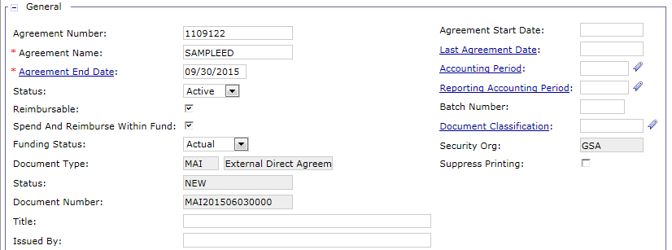
ED Header – General
Agreement Number - Identifying number all other transactions will reference
Agreement Name - Name of Agreement
Agreement End Date - Last date Agreement can be used to track spending
BDs can be processed through Last Bill Date but only 'new' spending through Agreement End Date
Reimbursable Flag - Allows for Agreements to be reimbursed via Billing Documents and Cash Receipts (set to True)
Notes:
Reimbursable
Indicates whether the Agreement is reimbursable or non-reimbursable. This field defaults to non-reimbursable. This option, in conjunction with the entered revenue source, will determine whether Collections against the Agreement should update the associated budgets’ and projects’ actual reimbursement amounts.

Slide 37
ED Header – General
Spend and Reimburse within Fund – Set to True for Manual Business Lines and External Services; unchecked for Outlease
Forces all spending transactions against Agreement to use the same fund that will be used for billing
Funding Status - Indicates the status of funding for the Agreement
Funds may be marked as Estimated or Actual (set to Actual)
Document Number - Generated upon Agreement document creation
NOT the Agreement Number

Slide 38
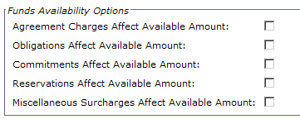
ED Header – Funds Availability
Agreement Charges Affect Available Amount - True for Agreements that bill by Agreement charges
Allows the Agreement to recognize Agreement Charge documents and draw down the Agreement Available Amount on the Agreement Query
Obligations Affect Available Amount - True for Agreements that bill by actual spending
Must be selected so that Spending will draw down Agreement Available Amounts on the Agreement Query
Commitments Affect Available Amount – True for Agreements that bill by actual spending
Must be selected so that Commitments will draw down Agreement Available Amounts on the Agreement Query
Reservations Affect Available Amount – False – currently not used by GSA
Miscellaneous Surcharges Affect Available Amount – False – not used in Phase 3

Slide 39
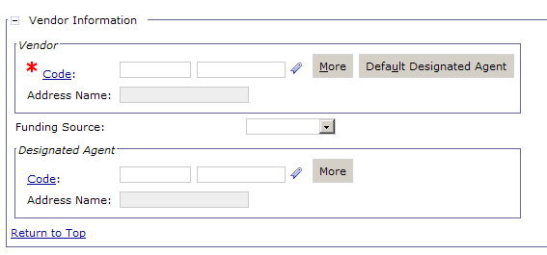
ED Header – Vendor Information
Vendor Code - Identifies the customer the Agreement is with
Designated Agent - If customer is an IPAC customer, this field allows the customer to be billed at the ALC level
Notes:
**For Non-Recurring Agreements, RETA sends an estimated calculated surcharge amount which is included in the Maximum Agreement Amount and Agreement Amount fields so that when a Surcharge Type is added to the Agreement it is already captured in the Agreement Line Amount. Therefore, RETA knows the surcharge amount and adds all direct spending costs and surcharge estimates to the Maximum Agreement Amount and Agreement Line Amount.
Example - If the Agreement is for $10,000, and the Surcharges will be $25, RETA knows this and sends over $10,025 when it establishes Agreement. Basically, RETA adds all direct spending costs and surcharge estimates to Max Agreement Amount and agr line amounts. This is for Non-Recurring Agreements only (only ones using surcharge functionality).
Recurring Agreements do not use surcharge functionality. RETA will send over as separate accounting line a one time $100 fee.

Slide 40
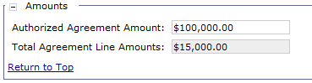
ED Header – Amounts
Authorized Agreement Amount - Maximum dollar value of the Agreement.
Agreement Line Amounts - Read Only. Aggregate dollar value of all Accounting Line amounts.
Note: In most cases the Authorized Agreement Amount and the Total Agreement Line Amounts will be the same amount.
However, these amounts will not match in cases where all agreement lines have not been entered for a particular agreement.

Slide 41
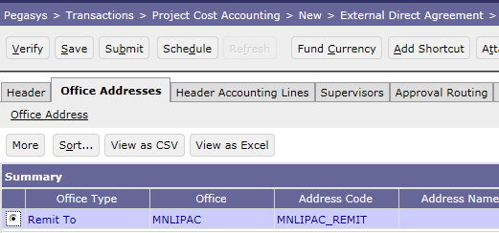
ED Office Addresses
The Office Address tab provides detailed Payment Office information about GSA for IPAC and Non-IPAC transactions
Office Type
Address
Remit To Office Address:
Used to on the generated Billing Document to provide the Remit To Office information on the PDF generated statement

Slide 42
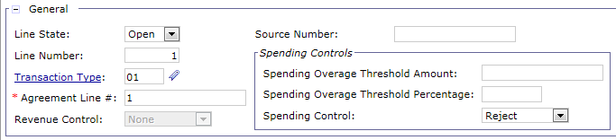
ED Header Accounting Lines – General
Line Number - Line number of Agreement Document
Transaction Type - Used to determine the associated General Ledger Postings and budgetary updates (via Accounting Event)
Agreement Line # - Line number of generated Agreement entity
Sequential number (1, 2, 3 etc.)
Revenue Control - For spending based Agreements, this flag prevents billing greater than spending (spending includes Surcharges). GSA will not use. Set to None

Slide 43
ED Header Accounting Lines – Spending Controls
GSA can set Spending Controls on Agreements in order to monitor and control spending amounts referencing the Agreement
Spending controls are entered on the Spending Controls section on the Header Accounting Line
A Spending transaction that exceeds the Agreement line spending threshold submitted for processing will not Process if the Spending Control on the Agreement is set to Reject
Spending Overage Threshold Amount - Sets the maximum amount that spending documents can exceed each referenced Agreement line amount
Spending Overage Threshold Percentage - Sets the maximum percentage that spending documents can exceed each referenced Agreement line amount
Spending Control – Determines how overspending should be processed in Pegasys

Slide 44
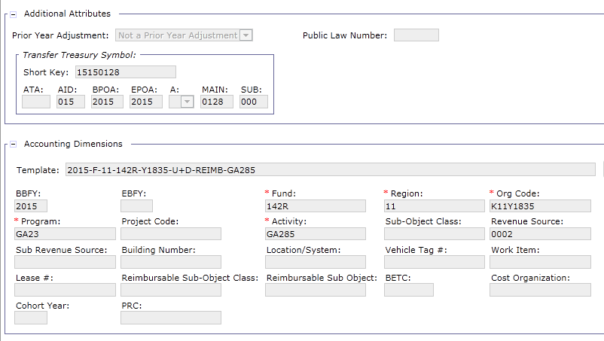
ED Header Accounting Lines
Maximum Billable Amount - The amount the line item is for
Prior Year Adjustment - Always set to Not a Prior Year Adjustment
Transfer Treasury Symbol – Associated with vendor/customer specified on the Agreement

Slide 45
ED Header – Treasury Account Symbol
Pegasys now displays the components related to the Treasury Account Symbol (TAS) throughout documents and queries, including:
Agreement Documents
Agreement Charges
Agreement Query
Treasury Symbol Components
ATA – Allocation Transfer Agency
AID – Agency Identifier
BPOA – Beginning Period of Availability
EPOA - Ending Period of Availability
A – Availability Type
Main – Main Account
Sub – Sub Account

Slide 46
ED Header Accounting Line Dimensions
Accounting Dimensions:
Note: Required fields will change based on the accounting template selected.
Fund
Region
Organization Code
Program
Building Number
Project Code
Activity
Sub-Object Class
Revenue Source

Slide 47
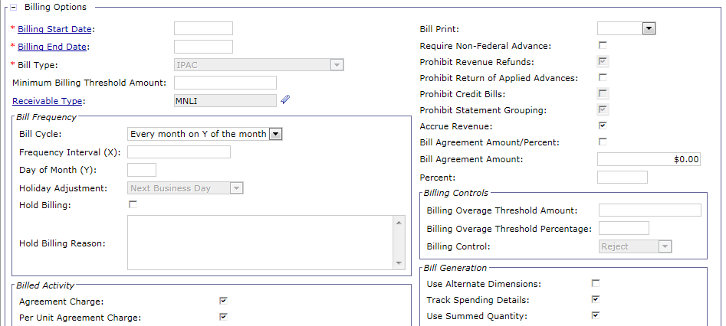
ED Header Accounting Lines – Billing Options
PCPROJBILL Batch Job will look to the Billing Options section for instruction on how to generate the unbilled Billing Documents and Advance Offsets

Slide 48
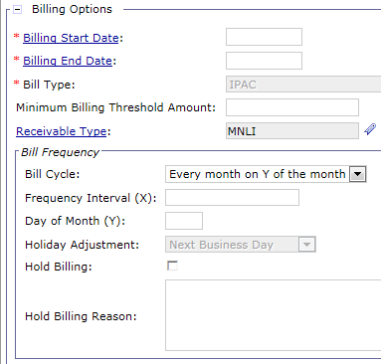
ED Header Accounting Lines – Billing Options
Minimum Billing Threshold - A bill will not generate if the Amount is not greater then the threshold and the end date has not passed
Frequency Interval (X) - Determines how often the automated billing process should consider billing the customer for Agreement. If Monthly, leave blank. If Quarterly, set to 88.
Day of Month (Y) - Determine which day of each month the automated billing process should bill
Holiday Adjustment - If billing setup dates fall on a holiday, this field provides alternate direction on when to bill
Billing Start & End Dates - The specified period in which BDs will be generated
Bill Type - Standard or IPAC
Bill Cycle - Provides instruction on how often to bill. If Monthly, set to Every month on Y of the month. If Quarterly/Annual, populate Every X days

Slide 49
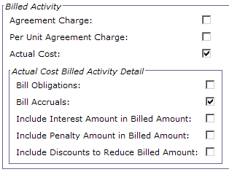
ED Header Accounting Lines – Billing Options
Agreement Charge - Indicates if Agreement charges should be included in the calculated billed amount for a particular Agreement
Per Unit Agreement Charge - Indicates if per unit Agreement charges should be included in the calculated billed amount for a particular Agreement
Actual Cost - Indicates whether line will bill by actual cost. True for Spending-based Agreements. When True, this flag triggers the generation of bills based on spending documents.
Bill Obligations - Indicates if bill will be by Obligations (i.e. Orders) Amount. GSA currently omits this functionality. Always set to False.
Bill Accruals - Indicates whether Accruals (i.e. Receipts) should be billed.

Slide 50
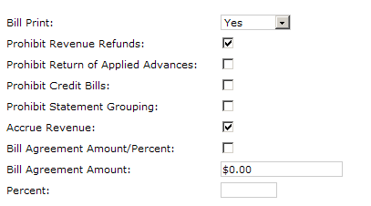
ED Header Accounting Lines – Billing Options
Bill Print - Sets the Bill created by PCPROJBILL to have a Bill Print flag = Yes
Prohibit Revenue Refunds – If set to True, this will not allow revenue refunds to be generated
Prohibit Return of Advances – If set to False, will allow return of unused Advances
Prohibit Credit Bills – If set to False, will allow credit bills to be generated by PCPROJBILL
Prohibit Statement Grouping – Set to True for Manual Business Lines for both IPAC and Non-IPAC
Bill Agreement Amount/Percent - Determines if bills will be generated based on specified Agreement amount or percentage populated in subsequent fields. True if recurring Agreement, False if Spending based Agreement
Bill Agreement Amount - For recurring Agreements, if Bill Agreement Amount/Percent flag = True, identifies the $ amount the Billing Document will be created for
Bill Agreement Percent - For recurring Agreements, identifies the % amount of the Agreement the Billing Document will be created for. GSA will not use

Slide 51
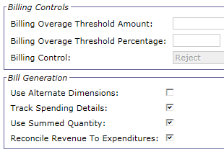
ED Header Accounting Lines – Billing Options
Bill Overage Threshold Amount - Amount the bill can be over the Accounting Line and not reject
Bill Overage Threshold Percentage - Percentage the bill can be over the Accounting Line amount and not reject
Billing Control - Billing control options for internal and external Agreements to control billing in excess of the Agreement line amount. Will be set to Reject
Use Alternate Dimension – False, not used by GSA P3 business lines
Track Spending Details - Allows the bills to have a link to the Spending Activity transactions
Use Summed Quantity - True for Manual Business Lines
Reconcile Revenue to Expenditure - Ensures that revenues match the Expenditure amount. Only used when tracking Spending Details set to True
Notes:
The Reconcile Revenue to Expenditure flag ensures that the Spending always equals the amount billed out no matter what manual adjustments are made on the Billing Document
For example, Scenario 1.
Period 1 In Period 2 End Period 2 PCPROJBILL runs
Spending for $100, Bill is generated by PCAS for $100 Bill is Manually Adjusted to $80 Because of this Flag = True, PCAS determines
Sent to customer Total Spending = $100, Billing = $80 total Expenditures, and then determines the total revenue. It will then see that total Expenditures is > total revenue. It will generate a BD with one Accounting Line for $20 BD to make reconcile revenue to total Expenditures. Billing = Spending.
For example, Scenario 2.
Period 1 In Period 2 End Period 2 PCPROJBILL runs
Spending for $100, Bill is generated by PCAS for $100 Bill is Manually Adjusted from $100 to $80 Because of this Flag = True, PCAS will see
Bill Sent to customer New Spending occurs for $30 that Billing was reduced, and spending is > Spending = $130, Billing = $80
It will then see that total Expenditures is > total revenue. It will create Billing Document with two accountings. 1st line- for new spending for $30. The second line will be in the amount of the manual reduction, for $20. Now the total Expenditure will equal $130, and Revenue will equal $130.

Slide 52
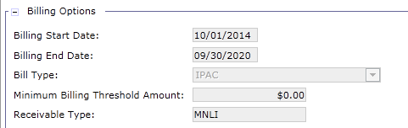
ED Settings for R6 Manual Business Lines
Bill Start Date- Date after which the first bill may be generated
Bill End Date - Date after which no more bills will be generated
Billing Type - Defaults according to ED document type selected

Slide 53
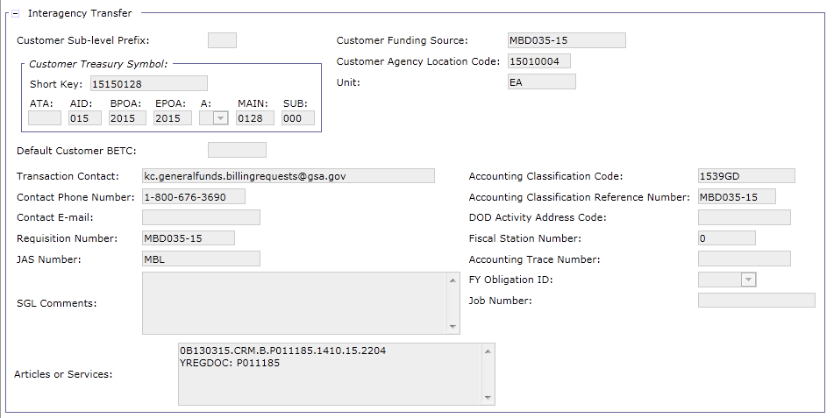
ED Header Accounting Line – Interagency Transfer
If External Agreement is with an IPAC customer the Interagency Transfer section must be completed
NOTE: The Customer Treasury Symbol must be populated for Federal customers. The system populates the Transfer Treasury Symbol values from the Customer Treasury Symbol short key and components when the form is verified or submitted for processing

Slide 54
Agreement Surcharges
Only applicable to Region 6 University For People manual business line for Phase 3
Surcharges allow GSA to charge the customer a markup above the cost of the good or service
Surcharge Types can be referenced on the Agreement defining how surcharges should be calculated and applied
Surcharge Generation batch job (PCSURGEN):
Identifies the Surcharge Type and calculates the surcharge amount based on the spending referencing the Agreement
Creates a Standard Voucher (SV) document and associates it to the Agreement to record the surcharge amount
CGI Federal Proprietary and Confidential

Slide 55
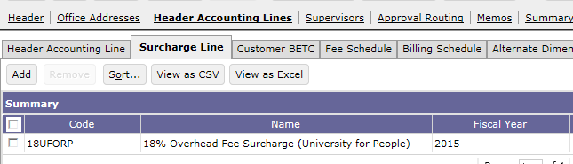
ED Header Accounting Line – Surcharge Line
University for People – 18% Overhead Fee:
Surcharge Amount is calculated by rate (18%) multiplied by current billing period spending amount referencing the Agreement

Slide 56
Internal Direct Agreements
Internal Direct (ID) Agreement
Used when GSA enters into an Agreement with another service/office/ business line within GSA
Includes the following:
Header
Header Accounting Lines
Header Accounting Line Sections
Buyer
Seller
Surcharges

Slide 57
Internal Direct Agreements (ID)
Similar to External Direct Agreements except:
Includes both the Buyer and Seller Accounting Information
Used upon generation of the NV to record the expense for the buyer and the revenue for the seller
Vendor info is recorded on Accounting Line for the buyer
Office Address tab is not utilized as all Agreements are within the GSA organization
Billing Options section contains less fields
Interagency Transfer section does not exist because internal Agreements are not used to generate IPAC bills
Notes:
Whereas EDs also include the Office Addresses

Slide 58
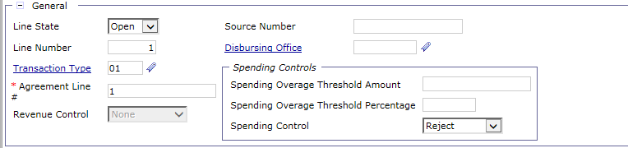
ID Header Accounting Lines – General
Line Number - Line number of Agreement Document
Transaction Type - Used to determine the associated General Ledger Postings and budgetary updates (via Accounting Event)
Set to 01 for expiring Funds, 02 for Revolving Funds
Agreement Line # - Line number of generated Agreement entity
Revenue Control - For Spending-based Agreements, this flag prevents billing greater than spending (spending includes Surcharges). GSA will not use. Set to None.

Slide 59
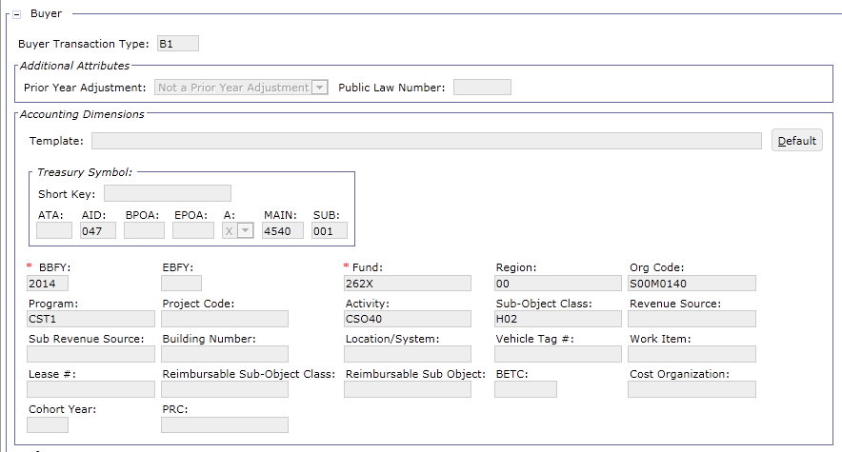
Header Accounting Lines – Buyer
DIFFERENTIATOR: Internal Agreements have a Buyer section:
Buyer Trans Type records expense for buyer: B1 (Interfund), B2 (Intrafund)
Indicates the Trans Type to be used for the buyer on the Internal Voucher (NV) that is generated by PCPROJBILL
Agreement does not post to the B1/B2 Trans Type
Includes specific accounting dimensions for buyer taken from the associated IX funding document
Uses a SOC (Sub-Object Class) code to record expense instead of a Revenue Source Code

Slide 60
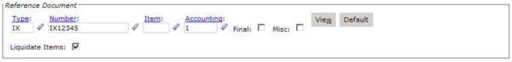
Header Accounting Lines – Buyer
DIFFERENTIATOR: Internal Agreements have a Buyer Reference Document & Vendor sections:
Reference Document: IX funding Document Type/Number/Accounting Line number is recorded
Note: If the IX being referenced is referencing a PCAS agreement, then the Agreement/Agreement Line Number from the IX must also be populated in the Buyer section of the agreement
Vendor: Vendor Code and Address Code information for the Buyer
Note: the Vendor Code will be a GSA vendor (i.e. 47####)

Slide 61
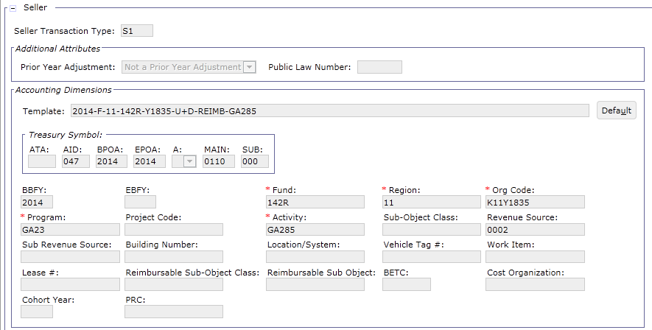
Header Accounting Lines – Seller
DIFFERENTIATOR: Internal Agreements have a Seller section:
Seller Trans Type records revenue for seller: S1 (Interfund), S2 (Intrafund)
Indicates the Trans Type to be used for the seller on the Internal Voucher (NV) that is generated by PCPROJBILL
If PCPROJBILL determines a credit Internal Voucher should be generated, the Seller Trans Type will be set to S3 on the Internal Voucher
Agreement does not post to the S1/S2 Trans Type
Includes specific accounting dimensions for seller
Uses a Revenue Source Code to record revenue (does not use a SOC code)

Slide 62
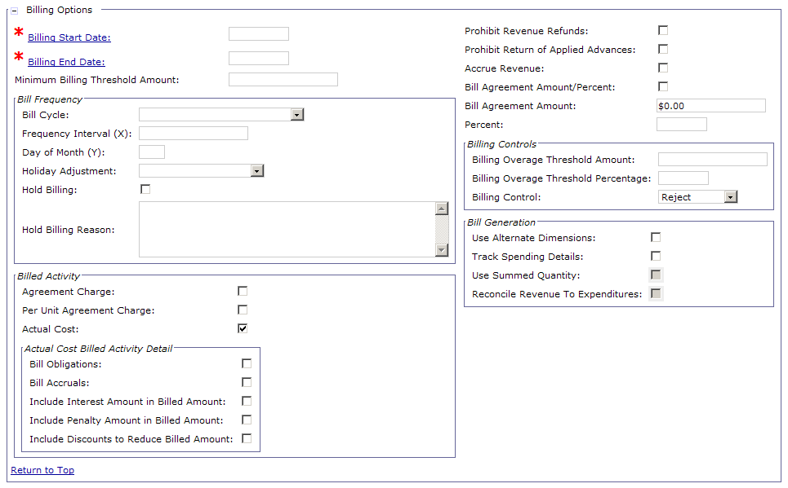
Header Accounting Line- Billing Options
DIFFERENTIATOR: Billing Options section for Internal Agreements contains less fields
No Bill Type/ Receivable Type
No Bill Print drop down as NVs are not generated/sent to customer
No Prohibit Credit Bills flag because Internal credits are recorded with a negative NV (no such thing as a credit line type on an NV) rather than a credit BD
No Prohibit Statement Grouping flag as NVs are not grouped to generate Statements

Slide 63
Agreement Entry Methods

Slide 64
Phase 3 Business Lines Using Agreements
Automated – PCAS Agreement generated in Pegasys via interface:
NOTE: AAS also uses PCAS Agreements generated in Pegasys via interface but follows the hybrid model and will be discussed in the DBR Billing course
Manual – PCAS Agreement generated in Pegasys via manual entry:
Business Line Name | Pegasys Business Line Value
Region 7:
Outlease | OUTLEASE
Business Line Name | Pegasys Business Line Value
Region 6:
Integrated Acquisition Environment (IAE) | R6MANUAL
Interagency Council (IAC) | R6MANUAL
Federal Citizen Services (FCS) | R6MANUAL
Great Seal of US | R6MANUAL
University For People (U for P) | R6MANUAL
External Services (USIP and Other Clients) | EXTSERVICE
Notes:
AAS also uses PCAS Agreements generated in Pegasys via interface but follows the hybrid model and will be discussed in the DBR Billing course

Slide 65
Business Line Agreements Created Via Interface
The following business lines use Agreements created via an interface:
Outlease - Automated creation via new Outlease Agreement Interface
Source system:
Occupancy Agreement Tool (OA Tool) system
Assisted Acquisition Services (AAS) - Automated creation via new AAS Agreement Interface
Source systems:
Regional Business Application (RBA)
National Business Application (NBA) systems
NOTE: AAS uses the PCAS/DBR Hybrid Billing vehicle which is discussed in the Phase 3 DBR Billing course.
CGI Federal Proprietary and Confidential
Notes:
AAS also uses PCAS Agreements generated in Pegasys via interface but follows the hybrid model and will be discussed in the DBR Billing course

Slide 66
Outlease Agreement Overview and Attributes
Outlease Agreements: Agreements used to lease the following types of space to private sector, or State and local Government entities:
Temporary
Underutilized/Excess
Customer Type: External Non-Federal
Billing Method: Standard (Non-IPAC)
Billing Model: Recurring
Flat Rate Billing
Advance Offsets
Monthly Statements in lieu of offset
Bill Generated Monthly if no Advance Payment is received
Internal Vouchers not used by Outlease
Receivables Lifecycle:
PCAS Receivables Lifecycle is used to support the processing of Outleases
and associated transactions
Notes:
Background Information from DES:
All Outlease Agreements will be External Direct (ED).
All Outlease Agreements will be a fixed monthly, quarterly or annual amount.
All Outlease Agreements are non-Federal (and non-IPAC).
All Outlease Agreements are Advance Pay Agreements. Ideally, the PCAS billing process should be creating advance offsets rather than bills as long as payments are made on time.
PCAS billing will offset cash advances each month until advances are exhausted.
PCAS billing will create bills when advances are exhausted. From a business perspective, the bill is considered delinquent as soon as it is created.
PCAS surcharges do not apply to Outlease Agreements.
For billing options, PCAS should never create advance offsets or bills such that total offsets plus total bills exceeds the total authorized amount of the Agreement.
There are no thresholds (billing is not allowed to exceed the established Agreement amount).
Spending controls are not applied to Outlease Agreements.
Outlease Agreements will have a single accounting line.
Agreement numbers will be the Outlease Contract number and will follow an established pattern that begins with “GS” (see Exhibit 6-1 for the exact format).
Outlease customers may be individual persons or corporations. Customers must exist as vendors in Pegasys, and Pegasys vendor records must be created (manually in Pegasys) prior to establishing an Outlease Agreement via this interface. The customer’s Pegasys vendor code and vendor address code must be supplied when establishing the Agreement.
Outlease vendors will be registered for VCSS.
Security Deposits may be collected when Outlease contracts are signed. The deposit is recorded via a Pegasys Cash Receipt (CR) document. Security deposit CRs do not reference the Agreement and are not viewable on the Agreement. Security deposit CRs are managed through a different fund.
At least one month’s rent is collected in advance.
Regular rent payments received through lockbox will be created as HELD documents in Pegasys. Agreement # and line # will have to be added manually before processing.

Slide 67
Outlease Agreement Overview and Attributes
Advance vs No Advance Processing:
Outlease Agreements are supposed to be paid in advance every month/quarter/year
Some Outlease customers fail to pay in advance
Advance Processing:
If customer has paid the Outlease in advance, revenue recognition is performed automatically via an Advance Offset
No Advance Processing:
If customer has not paid the Outlease in advance, revenue recognition is performed automatically via a customer billing (Pegasys Billing Document)
Agreement Created in Pegasys
Advance Received from Customer
Advance Offset Generated from Agreement
Agreement Created in Pegasys
Bill Generated from Agreement
Collection Received from Customer
Notes:
Background Information from DES:
All Outlease Agreements will be External Direct (ED).
All Outlease Agreements will be a fixed monthly, quarterly or annual amount.
All Outlease Agreements are non-Federal (and non-IPAC).
All Outlease Agreements are Advance Pay Agreements. Ideally, the PCAS billing process should be creating advance offsets rather than bills as long as payments are made on time.
PCAS billing will offset cash advances each month until advances are exhausted.
PCAS billing will create bills when advances are exhausted. From a business perspective, the bill is considered delinquent as soon as it is created.
PCAS surcharges do not apply to Outlease Agreements.
For billing options, PCAS should never create advance offsets or bills such that total offsets plus total bills exceeds the total authorized amount of the Agreement.
There are no thresholds (billing is not allowed to exceed the established Agreement amount).
Spending controls are not applied to Outlease Agreements.
Outlease Agreements will have a single accounting line.
Agreement numbers will be the Outlease Contract number and will follow an established pattern that begins with “GS” (see Exhibit 6-1 for the exact format).
Outlease customers may be individual persons or corporations. Customers must exist as vendors in Pegasys, and Pegasys vendor records must be created (manually in Pegasys) prior to establishing an Outlease Agreement via this interface. The customer’s Pegasys vendor code and vendor address code must be supplied when establishing the Agreement.
Outlease vendors will be registered for VCSS.
Security Deposits may be collected when Outlease contracts are signed. The deposit is recorded via a Pegasys Cash Receipt (CR) document. Security deposit CRs do not reference the Agreement and are not viewable on the Agreement. Security deposit CRs are managed through a different fund.
At least one month’s rent is collected in advance.
Regular rent payments received through lockbox will be created as HELD documents in Pegasys. Agreement # and line # will have to be added manually before processing.

Slide 68
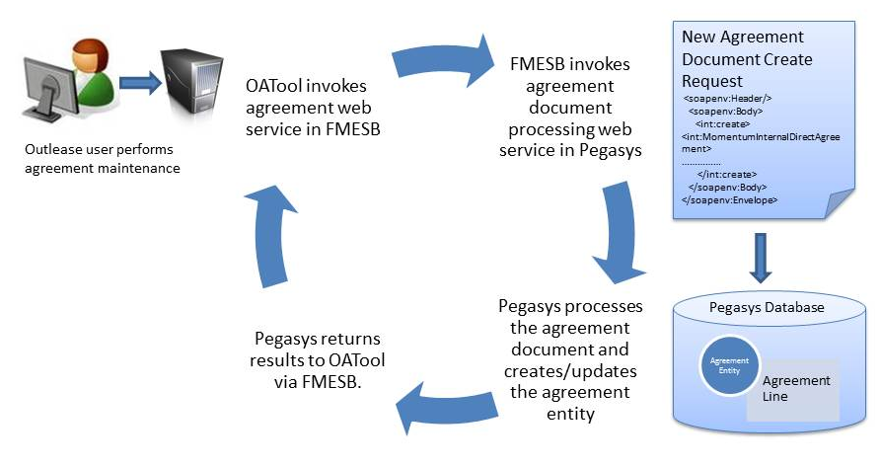
Outlease Agreement Interface
Web service-based interface from PBS OA Tool to Pegasys to establish/ maintain Outlease Agreements in Pegasys
Actions performed in Outlease trigger Agreement creation/updates in Pegasys
The following depicts the Outlease Agreement Interface between OA Tool and Pegasys:
Notes:
Maintained by Public Building Service (PBS) using a web service-based interface between OA Tool and Pegasys.

Slide 69
External Direct Agreement Document Types
External Direct (ED) Agreement
R7 Outlease – Agreement Document Types
Doc Type | Agreement Purpose
OED | Other
ORD | Retail
OFD | Restaurant
OOD | Office
OHD | Warehouse
OPD | Parking
OAD | Antenna
OMD | Movie/Photography
OSD | Special Events
OWD | Easement/Right-of-Way
OLD | Land Port of Entry (LPOE)
OCD | Credit Union
OUD | USPS

Slide 70
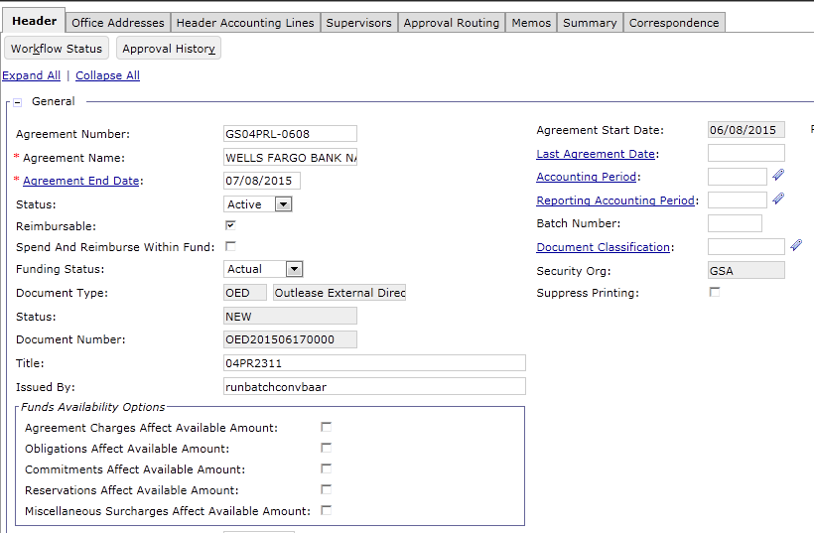
Outlease Settings: Header – General
Business Line | Outlease
Agreement Number | Required – this is the number that will be referenced on related documents
Agreement Name | Required
Agreement Start Date | Defaults to current date when ED is verified
Status | Defaults to Active
Business Line | Outlease
Agreement End Date | Enter end date of Agreement (Required)
Reimbursable | Defaults to True
Spend and Reimburse within Fund | Defaults to False
Fund Status | Defaults to Actual

Slide 71
Outlease Settings: Header – Funds Availability
Business Line | Outlease
Agreement Charges Affect Available Amount | unchecked
Obligations Affect Available Amount | unchecked
Commitments Affect Available Amount | unchecked
Reservations Affect Available Amount | unchecked
Miscellaneous Surcharges Affect Available Amount | unchecked

Slide 72
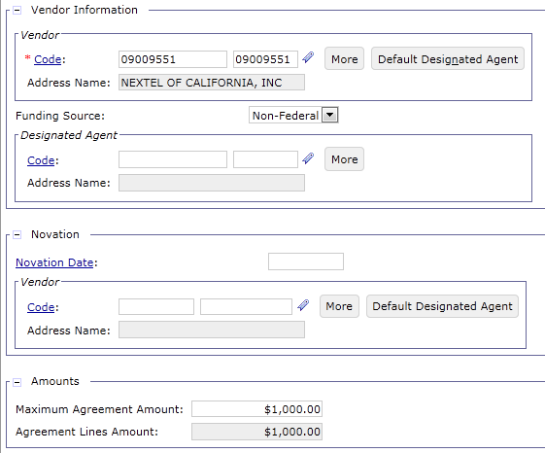
Outlease Settings: Header – Vendor
Business Line | Outlease
Vendor Code | Required – Lessee Vendor Code
Designated Agent | Not used by Outlease since all billing is Non-IPAC

Slide 73
Outlease Settings: Header – Amounts
Business Line | Outlease
Maximum Agreement Amount | Maximum total billable amount for the life of the Agreement
Total Agreement Line Amounts | Read Only. Aggregate dollar value of all Accounting Line amounts.

Slide 74
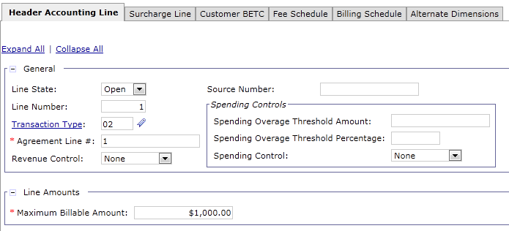
Outlease Settings: Accounting Line – General
Business Line | Outlease
Line Status | Defaults to Open
Line Number | Set to 1
Transaction Type | Set to 02
Agreement Line | Set to 1
Revenue Control | Defaults to None

Slide 75
Outlease Settings: Spending Controls
Business Line | Outlease
Spending Overage Threshold | Leave blank
Spending Overage Threshold Percentage | Leave blank
Spending Controls | Set to None

Slide 76
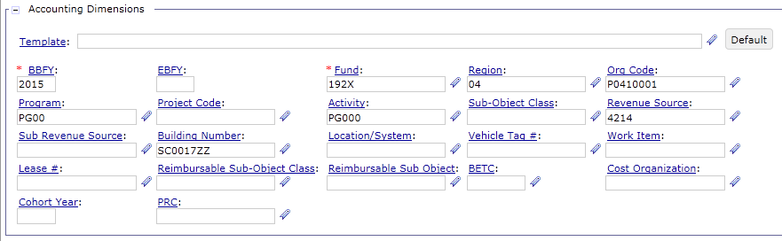
Outlease Settings: Accounting Dimensions
Business Line | Outlease
Accounting Dimensions | Use standard accounting dimensions but use Revenue Source Code rather than Sub-Object Class

Slide 77
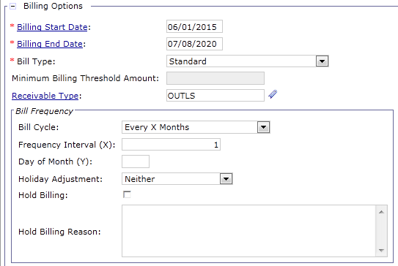
Outlease Settings: Billing Options
Business Line | Outlease
Bill Start Date | Required
Bill End Date | Required
Bill Type | Defaults to Standard for Outlease Agreements

Slide 78
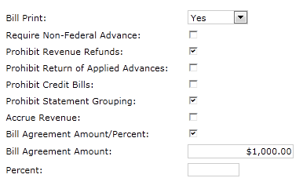
Outlease Settings: Billing Options
Outlease revenue recognition will be determined based on the Bill Agreement Amount and the Bill Frequency settings:
Business Line | Outlease
Bill Print | Set to Yes
Prohibit Revenue Refunds | Defaults to True
Prohibit Statement Grouping | Defaults to True
Bill Agreement Amount/Percent | Set to True
Bill Agreement Amount | Enter Amount to be billed each period

Slide 79
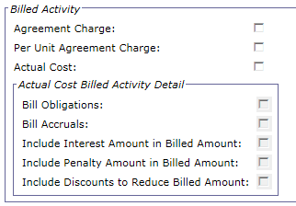
Outlease Settings: Billed Activity
Outlease revenue recognition will be determined based on the Bill Agreement Amount and the Bill Frequency settings
Billed Activity section not used on Outlease Agreements
 | Bill by Flat Rate
Business Line | Outlease
Agreement Charge | unchecked
Per Unit Agreement Charge | unchecked
Actual Cost | unchecked
Bill Obligations | unchecked
Bill Accruals | unchecked

Slide 80
Outlease Settings: Bill Frequency
Outlease revenue recognition will be determined based on the Bill Agreement Amount and the Bill Frequency settings:
Business Line | Outlease
Agreements Bill: | Monthly | Quarterly | Annually
Bill Cycle | Set to Every X Months | Set to Every X Months | Set to Every X Months
Frequency Interval (X) | Set to 1 | Set to 3 | Set to 12
Day of Month (Y) | Leave blank | Leave blank | Leave blank

Slide 81
Outlease Settings: Bill Frequency – Catch-up Billing
Catch-up Billing:
Result of delayed entry of agreement into OA Tool/Pegays
Agreements with delayed entry and Bill Frequency = Monthly:
Bill generation will occur monthly as expected
No further action needed once agreement is entered
Example: Bill Frequency = Monthly, Bill Amount = $100
Agreement Start Date = 7/1
Entered in OA Tool = 8/15
Bill Generation:
First bill generated during next billing cycle (9/1) for $300
Next bill generated for $100 during subsequent billing cycle (10/1), etc.

Slide 82
Outlease Settings: Bill Frequency – Catch-up Billing
Agreements with delayed entry and Bill Frequency = Quarterly or Annually:
Bill generation after 1st bill is generated will be based upon the Last Bill Generated Date instead of off Agreement Start Date
Example: Bill Frequency = Quarterly, Bill Amount = $100, Agreement Start Date = 7/1
No Delay in Entry (Entry date = 7/1)
Bills generated 7/1, 10/1, 1/1, etc.
Delayed Entry (Entry date = 8/15)
First bill generated during next billing cycle on 9/1 as expected
Subsequent bills generated based on Last Bill Generated Date, therefore, generated on 12/1, instead of 10/1

Slide 83
Outlease Settings: Bill Frequency – Catch-up Billing
Agreements with delayed entry and Bill Frequency = Quarterly or Annually:
Action needed for catch-up billing:
Upon delayed entry of agreement in OA Tool:
PBS will notify Region 7 of delayed entry
After first bill is generated:
PBS will enter a Support Request with USDA/GSA OCFO to request SQL update to Last Bill Generated Date
Date will be back-dated based on the Agreement Start Date

Slide 84
Exercise
Exercise 1 – Review a Processed Outlease Agreement Document

Slide 85
Manually Created Agreements
Agreements will be created manually for these Region 6 Business Lines:
Integrated Acquisition Environment
Manual processing of IPAC and Internal Agreements
Document Types (ED/ID): MAI (TT 02), MID (TT 02)
Bills based on Flat Rate/Percentage
Interagency Council
Manual processing of IPAC and Internal Agreements
Document Types (ED/ID): MAI (TT 02), MID (TT 02)
Bills based on Agreement Charges
Federal Citizen Services
Manual processing of IPAC and Internal Agreements
Document Types (ED/ID): MAI (TT 02), MID (TT 02)
Bills based on Actual Spending for Innovative Technology
Bills based on Agreement Charges for Publication Distribution

Slide 86
Manually Created Agreements
Great Seal of US
Manual processing of IPAC, non-IPAC and internal PCAS Agreement
Document Types (ED/ID): MAI (TT 02), MAN (TT 03), MID (TT 02)
Bills based on Agreement Charges
University For People
Manual processing of IPAC and non-IPAC "internal" PCAS Agreement
Document Types (ED/ID): MAI (TT 02), MID (TT 02)
Bills based on Actual Spending
External Services: USIP / Other Clients
Manual processing of IPAC and non-IPAC PCAS Agreement
Document Type (ED):
QAI (TT 01 if fund Type = APPR; TT 02 if Fund Type <> APPR),
QAN (TT 01 if fund Type = APPR; TT 02 if Fund Type <> APPR; TT = 03 if Vendor Type <> F)
Bills based on Agreement Charges for USIP / Other Clients
Bills based on Actual Spending for Other Clients

Slide 87
ED Settings for R6 Manual Business Lines
Specific settings on the Manual External Direct Agreement determine if it is:
Spending Based, Agreement Charge Based, Flat Rate Based
Monthly, Quarterly, Annually
IPAC, Non-IPAC, Interfund/Intrafund
Uses surcharges
The following series of slides will show specific settings to use for the R6 Manual Business Lines
Integrated Acquisition Environment
Interagency Council
Federal Citizen Services
Great Seal of US
University For People
External Services

Slide 88
ED Settings for R6 Manual Business Lines
Agreement Header - General
Business Line | IAE, Interagency Council, FCS, Great Seal of US, UFP, External Services
Agreement Number | Required – this is the number that will be referenced on related documents
Agreement Name | Required
Agreement Start Date | Defaults to current date when ED is verified
Status | Defaults to Active
Agreement End Date | Enter end date of Agreement (Required)
Reimbursable | Defaults to True
Spend and Reimburse within Fund | Defaults to True
Fund Status | Defaults to Actual

Slide 89
ED Settings for R6 Manual Business Lines
 | Bill by Flat Rate | Bill by Actual Spending | Bill by Agreement Charges
Business Lines | IAE | FCS – Publication Distribution Interagency Council Great Seal of US External Services - USIP | FCS - Innovative Technology External Services - Other
Agreement Charges Affect Available Amount |  |  | X
Obligations Affect Available Amount |  | X
Commitments Affect Available Amount |  | X

Slide 90
ED Header – Vendor Information
Business Line | IAE, Interagency Council, FCS, Great Seal of US, UFP, External Services
Vendor Code | Required
Designated Agent | Applicable to IPAC customers
Notes:
**For Non-Recurring Agreements, RETA sends an estimated calculated surcharge amount which is included in the Maximum Agreement Amount and Agreement Amount fields so that when a Surcharge Type is added to the Agreement it is already captured in the Agreement Line Amount. Therefore, RETA knows the surcharge amount and adds all direct spending costs and surcharge estimates to the Maximum Agreement Amount and Agreement Line Amount.
Example - If the Agreement is for $10,000, and the Surcharges will be $25, RETA knows this and sends over $10,025 when it establishes Agreement. Basically, RETA adds all direct spending costs and surcharge estimates to Max Agreement Amount and agr line amounts. This is for Non-Recurring Agreements only (only ones using surcharge functionality).
Recurring Agreements do not use surcharge functionality. RETA will send over as separate accounting line a one time $100 fee.

Slide 91
ED Header – Amounts
Business Line | IAE, Interagency Council, FCS, Great Seal of US, UFP, External Services
Authorized Agreement Amount | Update this amount if needed by processing additional ED/ID documents with the same Agreement Number.
Total Agreement Line Amounts | This is the amount that is expected to be expended of the Authorized Agreement Amount. Note: At the end of the Agreement, this Amount will be reduced to the higher of the Total Amount Spent or Total Collected Amount when the Agreement Unfilled Customer Order Reversal batch process is run.

Slide 92
ED Settings for R6 Manual Business Lines
Business Line | IAE, Interagency Council, FCS, Great Seal of US, UFP, External Services
Line Status | Defaults to Open
Line Number | Set to 1
Transaction Type | R6 Manual Business Lines: 02 External Services: 01 for Annual funds External Services : 02 for Revolving funds
Agreement Line | Set to 1 since R6 manual business lines should only have one Agreement line
Revenue Control | Defaults to None which is the correct value for R6 manual business lines

Slide 93
ED Settings for R6 Manual Business Lines
Business Lines | IAE, Interagency Council, FCS, Great Seal of US, UFP, External Services
Spending Overage Threshold Amount | Leave blank Do not use for Manual Business Lines
Spending Overage Threshold Percentage | Leave blank Do not use for Manual Business Lines
Spending Control | Set to Reject

Slide 94
ED Settings for R6 Manual Business Lines
Business Lines | IAE, Interagency Council, FCS, Great Seal of US, UFP, External Services
Bill Start Date | Required
Bill End Date | Required
Bill Type | Defaults according to ED document type selected

Slide 95
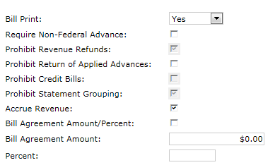
ED Settings for R6 Manual Business Lines
 | Bill by Flat Rate: IAE | Bill by Agreement Charges or Actual Spending: Interagency Council, FCS, Great Seal of US, UFP, External Services
Bill Print | Set to Yes | Set to Yes
Prohibit Revenue Refunds | X | X
Prohibit Statement Grouping | X | X
Bill Agreement Amount/% | X | Leave blank
Bill Agreement Amount | Enter Amount to be billed each month | Leave blank

Slide 96
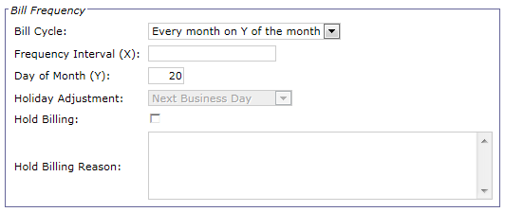
ED Settings for R6 Manual Business Lines
Agreements bill | Monthly | Quarterly | Annually
Business Line | IAE, Interagency Council, FCS, Great Seal of US, UFP, External Services | FCS, External Services | External Services
Bill Cycle | Set to Every month on Y of the month | Set to Every X Days | Set to Every X Days
Frequency Interval (X) | Leave blank | Set to 88 | Set to 360
Day of Month (Y) | Set to 20 Monthly bills are typically generated on the 20th of each month | Leave blank | Leave blank

Slide 97
ED Settings for R6 Manual Business Lines
 | Bill by Flat Rate | Bill by Actual Spending | Bill by Agreement Charges
Business Line | IAE | FCS – Publication Distribution Interagency Council Great Seal of US External Services - USIP | FCS - Innovative Technology External Services - Other
Agreement Charge |  |  | X
Per Unit Agreement Charge |  |  | X
Actual Cost |  | X
Bill Obligations |  | X
Bill Accruals

Slide 98
ED Header Accounting Line – Surcharge Line
Business Line | University For People
Surcharge Code | 18UFORP

Slide 99
Additional ED Settings for External Services
Additional fields are populated on External Services Agreement documents to ensure that they are identified on printed bills in the appropriate sections
The External Services specific fields are as follows:
On the Header Tab:
Client Name
On the Accounting Line Tab:
Class ID #
Charge Type
Student Name

Slide 100
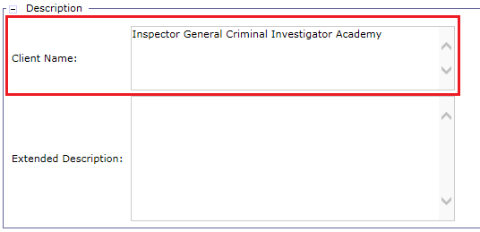
Additional ED Settings for External Services
Agreement Header
Business Lines | External Services
Client Name | Enter name of the client as needed

Slide 101
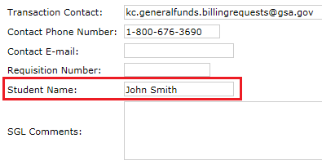
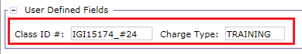
Additional ED Settings for External Services
Agreement Accounting Line
Business Lines | External Services
Student Name | Enter name of student as needed. Within the Interagency Transfer section.
Class ID # | Enter class identification number as needed. Value cannot contain spaces, apostrophes (‘), quotes (“), tildes (~), ampersands (&), or percent signs (%).
Charge Type | Enter type of charge as needed. Value cannot contain spaces, apostrophes (‘), quotes (“), tildes (~), ampersands (&), or percent signs (%).

Slide 102
Exercise
Exercise 2 – Create an External Direct Agreement
Exercise 3 – Create an Internal Direct Agreement

Slide 103
Agreement Query

Slide 104
Agreement Query
Agreement Entity:
Tracks advances, spending (i.e. costs incurred to fill customer order), surcharges, receivables, and collections via Pegasys transactions referencing the Agreement
Represents the cumulative effect of all transactions processed against the Agreement
Agreement Query:
Summary of all activity against the customer Agreement and a detailed transaction history for the Agreement Entity
Breakdown of spending including Commitments, Obligations, Expenditures, Agreement Charges, Surcharges, and Accruals
Breakdown of revenue including Receivables, Collections, Credits, Advances and Write-Offs
Can be searched at the Agreement Header Level or Accounting Line Level
Notes:
Provides a breakdown of revenue including Receivables, Collections, Credits, Advances and Write-Offs
Comment from R7 - R7 will focus be on the revenue

Slide 105
Agreement Query
The Agreement Query provides:
Summary of the Agreement Entity itself
View Agreement Documents used to:
Generate the Agreement Entity (the original Agreement document)
Update the Agreement Entity after original Agreement document processed
Summary of all spending/billing/collection activity processed against the Agreement
View summarized spending/billing/collection amounts referencing the Agreement
View individual spending/billing/collection transactions referencing the Agreement

Slide 106
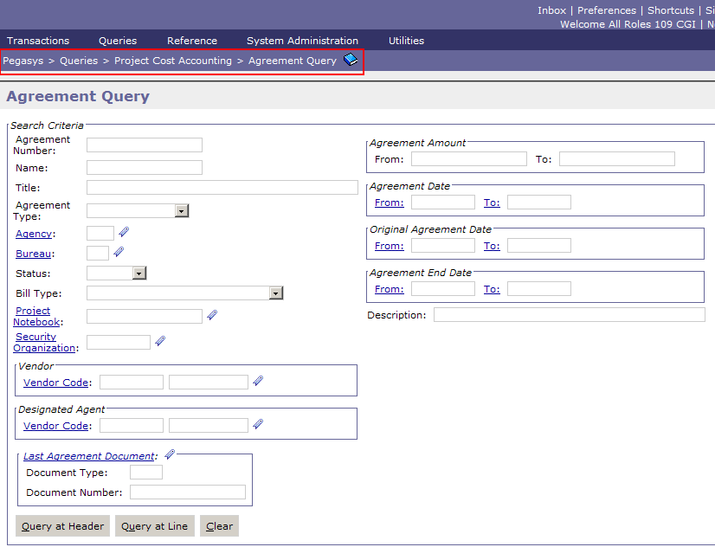
Agreement Query - Search
Notes:
As we move through the slides, we will discuss how each action updates the Agreement entity/query

Slide 107
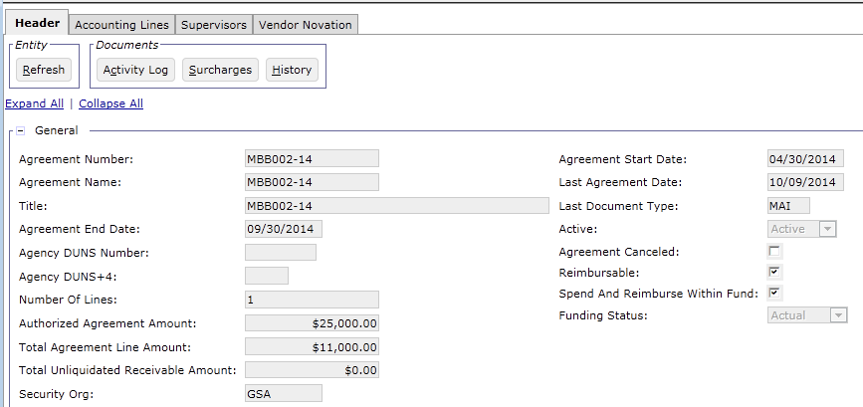
Agreement Query - General
Activity Log - Lists billing, collection and spending transactions referencing the Agreement
Surcharges - Lists all surcharge transactions referencing with the Agreement
History - Displays the history of the Agreement, including Agreement documents processed to increase/decrease the Agreement amount or make other changes

Slide 108
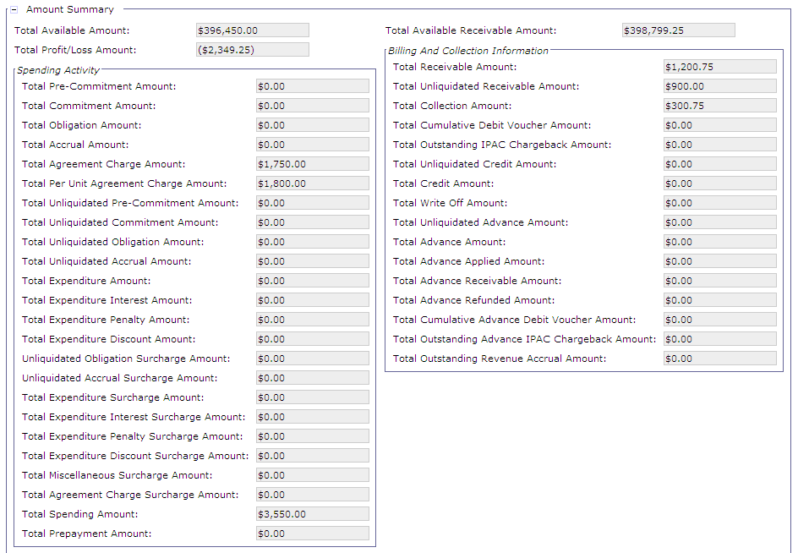
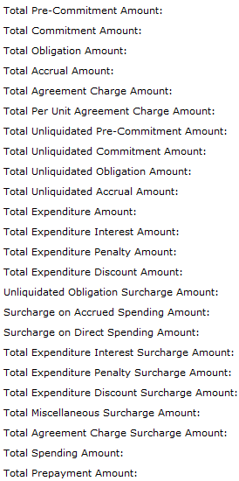
Agreement Query – Amount Summary

Slide 109
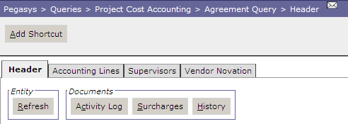
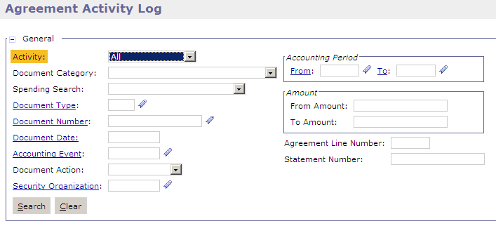
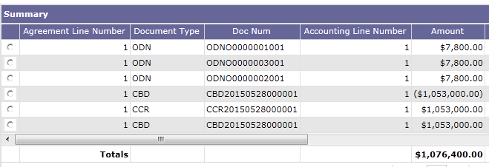
Agreement Query – Activity Log
Activity Log button – Allows users to search for and view all spending/billing-related transactions referencing the Agreement

Slide 110
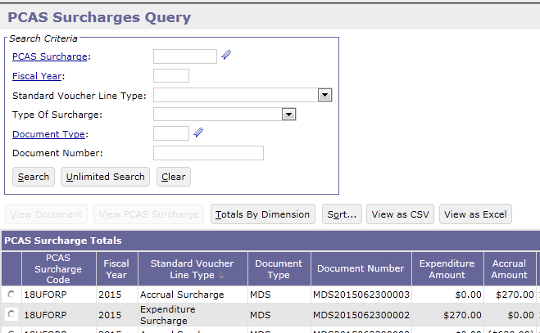
Agreement Query – Surcharge
Surcharges button – Opens the Surcharges Query and displays all surcharge documents associated with the Agreement

Slide 111
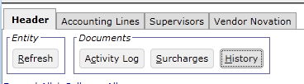
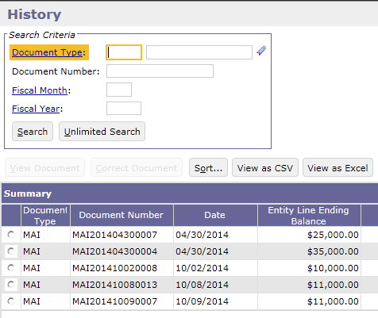
Agreement Query – History
History button:
Displays the original ED/ID document that established the Agreement as well as any subsequent ED/IDs that have updated the Agreement entity
Refresh button:
Refresh amounts displayed on Agreement since the last time the Agreement entity was opened or refreshed

Slide 112
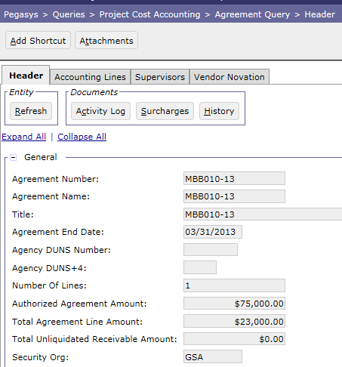
Agreement Query – Attachments
Attachments
Attachments can be added directly to the Agreement entity via the Agreement Query

Slide 113
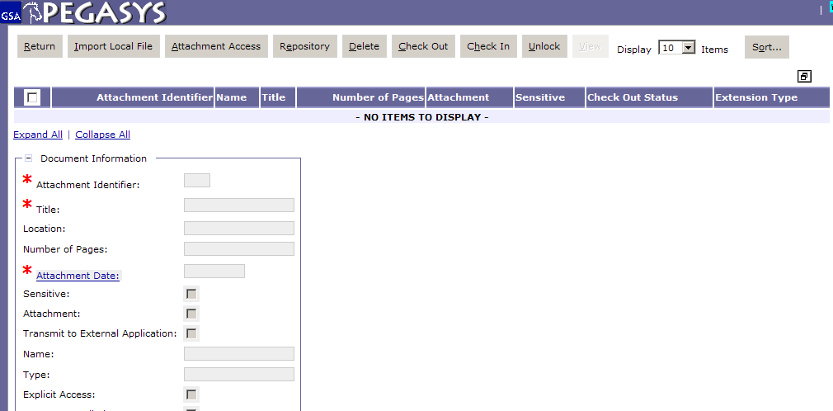
Add Attachments within the Agreement Query
Select Attachments Button
Select ‘Import Local File’
Enter Required and relevant fields
Select ‘Browse’ and choose file
Select ‘Upload’
Select ‘Return’

Slide 114
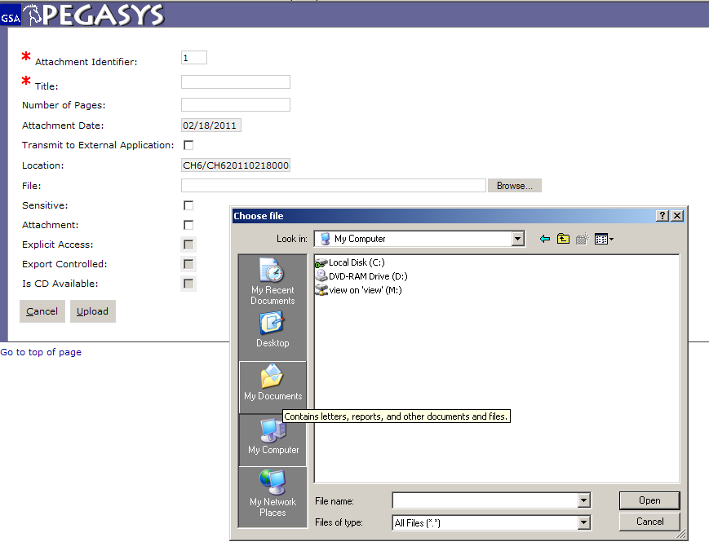
Add Attachments
Notes:
Fill in required fields marked with astrix, click Browse. Pop up window comes up. choose file, click open. When finished, click Upload

Slide 115
Exercise
Exercise 4 – View Newly Created Agreement Entity from Agreement Query

Slide 116
Segment 3: PCAS Pre-Billing
Transactions and Agreement
Entity Updates

Slide 117
Table of Contents
Segment 1: Project Cost Accounting System (PCAS) Overview
Segment 2: PCAS Agreements and Agreement Creation
Segment 3: PCAS Pre-Billing Transactions and Agreement Entity Updates
Pre-Billing Transaction Overview
Pre-Billing Collections
Pegasys Spending Documents
PCAS Agreement Charges
PCAS Surcharges
Segment 4: PCAS Unbilled Receivable Generation
Segment 5: PCAS Billed Receivable Generation
Segment 6: PCAS Accruals
Segment 7: Manual Credit Management
Segment 8: Billing-Related Collections
Segment 9: Receivable Management

Slide 118
Pre-Billing Transaction Overview

Slide 119
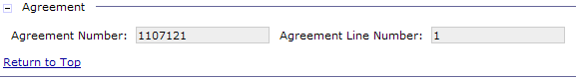
Pre-Billing Transactions
After an Agreement is established, pre-billing transactions can be processed against/referencing the Agreement…
Prior to recognizing revenue/generating a customer bill
Pre-Billing transactions include:
Advance Collections
Pegasys Spending Documents
PCAS Agreement Charges
PCAS Surcharges
Pre-Billing transactions are tracked against a PCAS Agreement by referencing the Agreement Number and Agreement Line Number
Notes:
Later in the presentation, we will show how all of these key concepts apply to the various P3 business lines for each of the regions.

Slide 120
Project Cost Accounting System Lifecycle
Establish Agreement
Spend Against Agreement
Generate Receivable and/or Earned Revenue
Agreement is Created (Interface or Manually)
Recurring | Spending Based
Bills by
Flat Rate | Agreement Charge (AG) | Actual Cost
Optional
 | Agreement Controls
Surcharges
AG/Spending Processed
Spending Based
Cost tracked by
Agreement Charge Document | Spending Docs (Order > Receipt)
From
Manual Entry
Surcharges Processed
Spending Based
Processed by
PCAS Surcharge Generation
Creating
SV Docs created according to values listed on Surcharge tab referencing Agreement
BD/NV/CR Offset Created
Recurring | Spending Based
Processed by
PCPROJBILL Refers to Agreement setup
Creating
Receivables Document for Agreement Amount, Spending Amount or Agreement Charge amount, + any Surcharge Amounts
Recurring Flat Rate Agreements do not bill based on spending/AGs
CGI Federal Proprietary and Confidential

Slide 121
Pre-Billing Collections

Slide 122
PCAS Pre-Billing Collections – Outlease
Outlease Security Deposits
The purpose of the security deposit is to:
Guarantee funds are available at the end of the lease to fix any damages to the leased premises
Offset any unliquidated bills generated as a result of the customer not sending in their advance rent payments
Although this is a type of pre-billing collection, the security deposit does NOT reference the Outlease Agreement
Always reject upon batch processing because there will never be a Billing Document reference
Manual correction to include Transaction Type, accounting dimensions, etc.

Slide 123
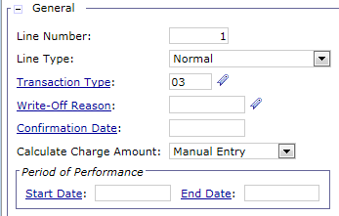
PCAS Pre-Billing Collections – Outlease
Outlease Security Deposit collections are processed using a Cash Receipt document with a Normal line type and specific Transaction Type
Region 7 Transaction Type – 03
Tracks customer security deposit via GSA Deposit Fund GL
Accounting Dimensions:
Fund – 197X
Region – 07
Org Code – D0700000
Program – YV00
Activity – GX000

Slide 124
PCAS Pre-Billing Collections
Advance Collections
Processed prior to GSA starting to fill the customer order (for work that has not yet been performed)
Required for non-Federal customers before spending can process against Agreement
Can be received:
For both non-Federal and Federal customers
Required for non-Federal customers, but not always received by GSA
Prior to creation of Agreement

Slide 125
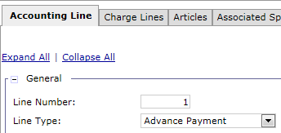
PCAS Pre-Billing Collections
Tracks “prepayment” as a liability because GSA has not yet filled the customer order or “earned” the prepayment
Advance collections are processed using a Cash Receipt document with an Advance Payment line type and specific Transaction Type
Region 6 Transaction Type: A4 (for advances associated with agreements)
Region 7 Transaction Type: 04
No billing when an advance has been recorded referencing Agreement:
Results in Advance Offset to record revenue

Slide 126
PCAS Pre-Billing Collections
Agreement with Federal Customer – does not require an advance collection:
Agreement Created in Pegasys
Spending Processed Against Agreement
Bill Generated from Agreement
Collection Received from Customer
Agreement with non-Federal Customer – requires an advance collection:
Agreement Created in Pegasys
Advance Received from Customer
Spending Processed Against Agreement
Advance Offset Generated from Agreement

Slide 127
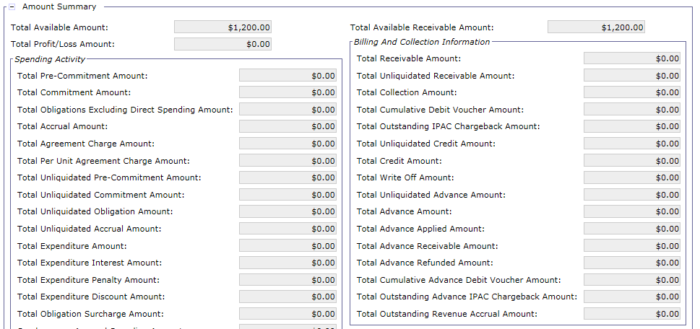
Agreement Entity – Before Advance Payment
Agreement is created for $1,200
The next step would be for the customer to send an advance payment so GSA can begin filling the order
Notes:
Agreement was created for $1,200. Before work could begin, the customer is required to send in advance.

Slide 128

Agreement Entity – After Advance Payment
Advance payment is processed for $600
The Total Collection Amount increases by the Advance
The Total Unliquidated Advance Amount increases by the Advance
The Total Advance Amount increases by the Advance
Notes:
Agreement was created for $1,200. Before work could begin, the customer was required to send in advance, which they did for $600.

Slide 129

Collections Query
The Collections Query provides GSA a single place to obtain information regarding all collections
Users with the appropriate Collections role have the capability to amend/correct Cash Receipt forms and documents from the Collections Query
Amend is used on Processed CR Documents
Correct is used on Held/Rejected CR Forms

Slide 130
Collections Query
General Key Search Fields
Document Type/Number
Document Status
Vendor Info
Accounting Dimensions
Collection Specific Key Search Fields
Line Type (Normal, Advance, etc.)
Applied or Unapplied collections
Input System (Lockbox, Pay.gov, etc.)
Business Line
Document Date
Statement Number
Accounting Line Number
Deposit Number
Receivable Type
Agreement Number

Slide 131

Collections Query
Navigate to Queries > Accounts Receivable > Collections Query
Notes:
Discuss search parameters:
All parameters highlighted in red are fields that are unique to the Collections Query (not on the Form/Doc Query)

Slide 132

Collections Query
Notes:
Discuss additional criteria and vendor search (i.e. Reference document information, External System ID, Vendor Code etc.)
Applied to billing Criteria: Users can search for applied or unapplied collections with this.
Bill Type: IPAC or Standard

Slide 133

Collections Query
Notes:
Discuss user defined fields and accounting dimensions search criteria

Slide 134



Collections Query
Returns the Referenced BD or CR info
Notes:
Through the collections query, users can not only view Cash Receipt documents, but also the Billing documents they are referenced too. To open the reference, select the record and click the Reference button.

Slide 135



Correcting Rejected/Held Collections

Slide 136






Collections Query: Scenarios
Example scenarios of when the Collections Query would be used:
A user is searching for collections received from a particular Input System, e.g. ECP – Lockbox, Pay.gov, etc.
A user wants to query for any Returned Checks processed in the past month to search for re-opened bills
The user is querying for Held collections referencing a particular Agreement
A user needs to query for a collection document using the Debit Voucher Number
The user is querying for all Credit Application funds returned to Treasury using doc type CT6/CT7
A GSA user would like to query all processed collections referenced to an individual statement number
Notes:
Box 1: In the Form/Doc select query, an amount range can be entered but it’s not line specific like on the Collections Query.

Slide 137

Collections Query: Scenarios (Cont.)
Region 7 Outlease Lockbox Advance CRs
Search Criteria:
Document Type = L7M
Status = Rejected
Business Line = OUTLEASE
These transactions will enter Pegasys without a Line Type
User must:
Research the Rejected transaction on the Collections Query
Correct the L7M to pull the Agreement Number from the CR Extended Description
Set the Line Type to Advance Payment
Notes:
Box 1: In the Form/Doc select query, an amount range can be entered but it’s not line specific like on the Collections Query.

Slide 138
Exercise
Exercise 5 – Correct and process Advance Collection via Collections Query and Review Agreement Entity updates

Slide 139
Pegasys Spending Documents

Slide 140
Pegasys Spending Documents
For Spending-based Agreements, Spending Documents must be created referencing the Agreement
Spending Documents exist in Pegasys Purchasing functionality
Create Order
Copy Forward the Order to a Receipt
When creating the Order and Receipt, the Agreement Number and Agreement Line Number must be entered on the Header Accounting Line in order to reference the Agreement and draw down the Agreement amount
Accounting Event recorded on the Transaction Definition used by the spending document determines the corresponding Agreement updates

Slide 141
Pegasys Spending Documents
For Spending-based Agreements, actual costs are processed against the Agreement via Pegasys Spending Documents
The following R6 Manual Business Lines use Agreements which bill by actual costs (i.e. Pegasys Spending Documents):
Federal Citizen Services (FCS) - Innovative Technology
University For People (UFP)
External Services – Other Clients

Slide 142
Spending Controls
GSA can set Spending Controls on Agreements in order to monitor/manage spending amounts referencing each Agreement
Spending controls are entered on the Spending Controls section on the Header Accounting Line
A Spending transaction that exceeds the Agreement line threshold submitted for processing will not process if the Spending Control on the Agreement is set to Reject
R7 Outlease
The spending controls will be set to None since Agreements bill based on flat rate, not spending
R6 Manual Business Lines
The spending controls will be set to Reject with no overage thresholds

Slide 143

Agreement Entity – Before Spending
A Spending- Based Agreement is created for $5,000
The next step would be to process Pegasys spending documents against the Agreement

Slide 144

Agreement Entity – After Spending
A purchase order is created against Agreement for $1,500
The order is copied forward to create a receipt for $1,500
Total Obligation Amount = $1,500 Total Accrual Amount = $1,500 Total Unliquidated Accrual Amount = $1,500 Total Spending Amount = $1,500
The Total Available Amount is decrease by the Total Spending Amount
The Total Profit\Loss Amount is decrease by the Total Spending Amount
Notes:
Agreement was created for $3,500. Spending (order & receipt) occurred against the Agreement for $1,500.

Slide 145
PCAS Agreement Charges

Slide 146
PCAS Agreement Charges
Agreement Charges capture costs that cannot be readily differentiated via Spending transactions
For example:
The Spending incurred could have been captured in lump sum, and thus not distinguishable for the specific good or service provided
Spending amount is identifiable but does not reference the Agreement
Agreement Charge (AG) Documents are established in Pegasys to prompt PCPROJBILL to recognize revenue on Agreement (via Billing Document or Advance Offset)
AG Documents are configured not to impact the General Ledger
Prevents double counting Expenditures in the General Ledger as the Spending was processed on a separate transaction
This actual spending does not reference the Agreement

Slide 147
PCAS Agreement Charges
For Agreement Charge-based Agreements, “spending” is processed against the Agreement via Agreement Charge Documents
Document Type: MCH (Manual Business Lines Agreement Charge)
The following R6 Manual Business Lines use Agreement which bill according to Agreement Charges:
Interagency Council
Federal Citizen Services (FCS) - Publication Distribution
Great Seal of US
External Services – United States Institute of Peace (USIP) and Other Clients

Slide 148

MCH Agreement Charge Header
Agreement – Once the Agreement Number is completed the system will populate the Agreement Name
Vendor – the vendor from which goods/services were procured

Slide 149

MCH Agreement Charge Accounting Line
Agreement Number/Name – The Number and Name are populated from the values on the Header page
Line - Must be completed to reference the line of the corresponding Agreement

Slide 150

Agreement Entity – Before Agreement Charge
An Agreement which bills by Agreement Charges is created for $6,000
$1000 of spending occurred but did not reference the Agreement
The next step would be for GSA to process an Agreement Charge for $1,000

Slide 151

Agreement Entity – After Agreement Charge
An Agreement Charge is created for $1,000 referencing the Agreement
Total Available Amount decreases by the amount of the Agreement Charge
The Total Profit/Loss Amount decreases by the amount of the Agreement Charge
The Total Agreement Charge Amount increases by the amount of the Agreement Charge
The Total Spending Amount Including Commitments increases by the amount of the Agreement Charge

Slide 152
Exercise
Exercise 6 – Process Agreement Charge against Agreement and Review Agreement Query Updates

Slide 153
PCAS Surcharges

Slide 154
Agreement Surcharges
Agreement Surcharges
Allow GSA to charge the customer a markup above the cost of the goods/services provided
PCAS Surcharge Types:
Maintained on the Surcharge Maintenance table and define how surcharges should be calculated and applied
Can be added to the Agreement Accounting Line Surcharges tab
Phase 3 Surcharges Types:
Business Lines: University for People only
18% flat overhead fee surcharge calculated on Agreement spending
Document Type: MDS (SV Document with null posting)
Transaction Type: 01

Slide 155
PCAS Surcharge Process
After spending or Agreement Charge Documents are created and referenced on Agreement, the Surcharge process occurs
Surcharges are created/processed by the PCAS Surcharge Generation Batch process (PCSURGEN)
SV Documents are processed referencing the applicable Agreement and Agreement Line Number
A Standard Voucher with a Surcharge Line Type is created for each Surcharge line entered on Agreement
The Surcharge Documents are created according to the Surcharge Type and setup on the Surcharges tab in the Agreement
Calculates the Surcharge Amount based on the rate set on the Surcharge maintenance table
Notes:
Note, Agreement Charge & Spending is optional. Surcharges can be added to Flat Rate Agreements as well.

Slide 156

PCAS Surcharge Generation
PCAS Surcharge Generation
UFPPCSURGEN - Overhead Fee Surcharge Generation - University for People
PCSURGEN
Determines Agreements eligible for Surcharge by looking to see if a Surcharge Type is referenced on the Agreement line
Identifies the Surcharge Type on the Maintenance Table
Calculates the Surcharge Amount based on the information documented on the Surcharge Type
Creates/processes a Surcharge SV for the calculated Surcharge Amount referencing the appropriate Agreement Number/Line Number

Slide 157

PCAS Surcharge Standard Voucher - Header
Document Number – Number assigned by the system when the SV is generated
Amount – The value of the SV

Slide 158


PCAS Surcharge SV – Accounting Lines
Agreement Number/Line Number - Determine the Agreement with which the surcharge is associated

Slide 159
PCAS Surcharge - Accrual vs Expenditure
When the order is processed against the Agreement, PCSURGEN will not generate a surcharge
When the receipt (referencing the order) is processed against the Agreement, PCSURGEN will generate an accrual surcharge
When the payment (referencing the receipt) is processed against the Agreement, PCSURGEN will not generate a surcharge
When the payment (not referencing the receipt) is processed against the Agreement, PCSURGEN will generate an expenditure surcharge

Slide 160

PCAS Surcharge - Accrual vs Expenditure
PCAS Surcharge: Surcharge Type that generated the surcharge SV: 18UFORP
Line Type =
Accrual Surcharge – generated for receipts
Expenditure Surcharge – generated for itemized payments
Transaction Event = Expenditure
Increase/Decrease = Increase
Surcharge line processed as increase to the GL
Amount = Calculated surcharge amount

Slide 161
Agreement Entity – Before Surcharges
A Spending-based Agreement is created for $5,000, with an overhead fee of 18% for spending transactions
An order is created referencing the Agreement for $1,500
A receipt is copied forward from the order for $1,500
The next step would be for PCSURGEN to generate a surcharge against the Agreement
Notes:
Agreement was created for $3,500. Spending (order & receipt) occurred against the Agreement for $1,500.

Slide 162

Agreement Entity – After Accrual Surcharges
PCSURGEN generated a PCAS Surcharge SV (MDS) against the Agreement for 18% of the amount of the receipt or $270
The Surcharge on Accrued Spending Amount increases by the amount of the Accrual Surcharge
The Total Spending Amount increases by the amount of the Accrual Surcharge
The Total Available Amount decreases by the amount of the Accrual Surcharge
The Total Profit/Loss Amount decreases by the amount of the Accrual Surcharge

Slide 163

Agreement Entity – After Expenditure Surcharges
Suppose in the previous scenario, the receipt was never created and instead the order was copied forward to a payment referencing the Agreement.
PCSURGEN generated a PCAS Surcharge SV (MDS) against the Agreement for 18% of the amount of the payment or $270
The Surcharge on Direct Spending Amount increases by the amount of the SV Surcharge
The Total Spending Amount increases by the amount of the SV Surcharge
The Total Available Amount decreases by the amount of the SV Surcharge
The Total Profit/Loss Amount decreases by the amount of the SV Surcharge

Slide 164
Agreement Entity – View Surcharges
Surcharges button – Opens the Surcharges Query and displays all surcharge documents associated with the Agreement

Slide 165
Segment 4:
PCAS Unbilled Receivable Generation

Slide 166
Table of Contents
Segment 1: Project Cost Accounting System (PCAS) Overview
Segment 2: PCAS Agreements and Agreement Creation
Segment 3: PCAS Pre-Billing Transactions and Agreement Entity Updates
Segment 4: PCAS Unbilled Receivable Generation
PCAS Project Bill Generation Batch Job
Segment 5: PCAS Billed Receivable Generation
Segment 6: PCAS Accruals
Segment 7: Manual Credit Management
Segment 8: Billing-Related Collections
Segment 9: Receivable Management
Segment 10: Expiring Unfilled Customer Order Reversal
Segment 11: Mass Import
Segment 12: PCAS Reports

Slide 167
PCAS Project Bill
Generation Batch Job

Slide 168
Project Cost Accounting System Lifecycle
Establish Agreement
Spend Against Agreement
Generate Receivable and/or Earned Revenue
Agreement is Created (Interface or Manually)
Recurring | Spending Based
Bills by
Flat Rate | Agreement Charge (AG) | Actual Cost
Optional
 | Agreement Controls
Surcharges
AG/Spending Processed
Spending Based
Cost tracked by
Agreement Charge Document | Spending Docs (Order > Receipt)
From
Manual Entry
Surcharges Processed
Spending Based
Processed by
PCAS Surcharge Generation
Creating
SV Docs created according to values listed on Surcharge tab referencing Agreement
BD/NV/CR Offset Created
Recurring | Spending Based
Processed by
PCPROJBILL Refers to Agreement setup
Creating
Receivables Document for Agreement Amount, Spending Amount or Agreement Charge amount, + any Surcharge Amounts
Recurring Flat Rate Agreements do not bill based on spending/AGs
CGI Federal Proprietary and Confidential

Slide 169
PCAS Project Bill Generation Functionality
PCPROJBILL determines if an Agreement is ready to bill based on:
Agreement Bill Frequency settings (defined on the Agreement line )
Agreement Bill Type settings (defined on the Agreement line)
Pre-billing transactions referencing the Agreement (when applicable) *
Once:
Agreement is Established
Pre-billing transactions are processed*
Surcharge Generation creates applicable surcharges*
…the revenue recognition transaction is then generated
* Depending on Agreement type/business line

Slide 170
PCAS Project Bill Generation Functionality
The following revenue recognition transactions are created by PCPROJBILL:
Billing Documents: Used to bill and credit external customers
GSA will initially create Billing Documents as “unbilled”
Generates either a non-IPAC or IPAC BD per the customer type
BD- Credit Line Type: Used to record credit amounts owed to customer
Advance Offset Cash Receipts: Used to offset Advance Payments
Record earned revenue
Liquidate liability originally posted by Advance Payment
Utilize the Advance Offset Line Type
Internal Voucher: Used to record:
Expense for internal GSA customers (i.e. “the buyer”)
Revenue for GSA provider (i.e. “the seller”)

Slide 171
PCAS Project Bill Generation Functionality
PCPROJBILL:
Creates revenue transactions based on one of the following:
Spending Amount - If the Agreement is Spending based, looks at the chain of “unbilled” spending documents and amounts since last billing
Agreement Charges Amount – If the Agreement bills by Agreement Charges, sums all “unbilled” Agreement charges since last billing
Flat Rate Amount - If the Agreement uses a Flat Rate, looks to the billing amount listed in the Billing Options section
Plus any Surcharge Amount processed by the Surcharge job if applicable
Notes:
**NOTE- If a PCPROJBILL-generated BD rejects for whatever reason, it should not be deleted (and then a new one created manually). Instead, the errors should be corrected and the BD should be submitted for processing.

Slide 172
Billing Document (IPAC and Non-IPAC)
Billing Document (BD) - Performs two billing related functions:
Facilitates billing for services rendered or goods delivered
Records the financial impact of providing goods/services to external customers:
General Ledger impact: Accounts Receivable and Revenue
Two types of Billing Documents processed coinciding with the billing methods used by GSA’s Phase 3 business lines:
Non-IPAC
IPAC
Line Types (default to Normal for all Billing Documents)
Normal – used to recognize revenue
Credit – allows the recording of a liability
Attachments can also be added to documents

Slide 173
PCPROJBILL- Unbilled BD Document Types
R7 – Automated
R6 - Manual
Business Line | Document Category | Document Type | Name
Outlease | Billing Document | ODN | Outlease Non-IPAC BD
Business Line | Document Category | Document Type | Name
IAE, Interagency Council, FCS, Great Seal of US, U For P | Billing Document | MDI | Manual Business Lines IPAC BD
IAE, Interagency Council, FCS, Great Seal of US, U For P | Billing Document | MDN | Manual Business Lines Non- IPAC BD
External Services | Billing Document | QDI | External Services IPAC BD
External Services | Billing Document | QDN | External Services Non-IPAC BD

Slide 174

Billing Documents – Header
Document Number – Assigned by the system when the PCPROJBILL batch job is executed
Bill Generated Flag – Indicates whether or not the bill has been generated. Only viewable after document has processed
Business Line – EXTSERVICE, R6MANUAL or OUTLEASE
Notes:
Non-IPAC BD uses a Non-IPAC vendor
IPAC BD uses an IPAC vendor

Slide 175

Billing Documents – Accounting Line
Line Type - Indicates the type of transaction recorded on the accounting line
Billing Status – Billed or Unbilled
Receivable Type - The receivable type that is associated with the flexible transaction definition
Bill Print - Determines if this bill is printed or is suppressed
Notes:
New Associated Spending Tab – displays all spending documents associated to the revenue transaction line. Only visible when the referenced Agreement line has 'Track Spending Details' flag = true.

Slide 176



Non-IPAC Billing Document
Non-IPAC Remit To address
Non-IPAC Vendor on Header
Blank Interagency Transfer information on Accounting Line

Slide 177
Billing Document (IPAC)
IPAC Billing Documents:
IPAC Billing Documents are generated for customers configured in Pegasys to use IPAC
IPAC Statements are generated via PDF and can be viewed from Pegasys and VCSS
IPAC Statements provide the ability to group many Billing Documents together to bill customers in one consolidated bill at the ALC level
Notes:
The article is only used on IPAC transactions. Articles are derived from the old SF1080/SF1081 and that is how they became in Pegasys.

Slide 178
Billing Document (IPAC)
IPAC Billing Documents:
IPAC Billing Documents are generated for customers configured in Pegasys to use IPAC
IPAC Statements are generated via PDF and can be viewed from Pegasys and VCSS
Similar to Non-IPAC Billing Documents, except:
IPAC Billing Documents contain ‘Articles’:
Capture commodity/unit information, quantity, and unit price
Transmit this information to IPAC to be viewable on the customer’s IPAC record
Document the transaction's IPAC Status
Used to determine the state of the IPAC transaction within the IPAC lifecycle
Children of the Accounting Line
IPAC Statements provide the ability to group many Billing Documents together to bill customers in one consolidated bill at the ALC level
Notes:
The article is only used on IPAC transactions. Articles are derived from the old SF1080/SF1081 and that is how they became in Pegasys.

Slide 179

Billing Document: IPAC/ Normal Line Type
IPAC Billing Document Overview: Inter-Agency Transfer Section
IPAC Bills - designated as IPAC by:
Inter-Agency Flag (Set to True) on BD header, AND
Type of Transfer (set to IPAC)
Interagency flag, Type of Transfer, Use Statement Number for IPAC, IPAC Article Qty/Unit Price Indicator are defaulted when an IPAC document type is selected

Slide 180
Billing Document (IPAC)
IPAC Billing Document Overview: Use Article Qty/Unit Price
'Use Article Qty/Unit Price' is used by Manual Business Lines to send IPAC transaction information at accounting line/Article level
'Use Article Qty/Unit Price' setting is used to send information in the outbound IPAC file from the Article and accounting line
Manual Business Lines: transaction information will be sent for each individual accounting line
All IPAC settings listed above are defaulted for manual documents using Doc Type extensibility

Slide 181

Billing Document – IPAC Articles
Qty/Unit Price Indicator – Indicates the configuration of the summation of article quantity and unit price when the IPAC BD accounting line has associated detail billing records
Article Amount – Calculated
IPAC Status – Refers document and its interaction with the IPAC Interface
Articles or Services - items or services for which the user is billing the customer agency
Notes:
this is where the itemization/commodity information is recorded for BD/CRs

Slide 182
Billing Document - Agreement Entity
All Documents generated by PCPROJBILL will copy forward the Agreement Number and Accounting Line to the Agreement Section
This link will cause updates to the Agreement Entity to occur dynamically as documents are processed

Slide 183

Additional BD Settings for Region 6 Manual Business Lines
Region 6 Manual Business Line Agreement-based BDs:
External System ID = R6MNLAGRE
On Header of BD
Within External System Information section

Slide 184
Additional BD Settings for External Services
Additional fields are populated on External Services Billing Documents to ensure that they are identified on printed bills in the appropriate sections
The External Services specific fields are as follows:
On the Header Tab:
Client Name
On the Accounting Line Tab:
Class ID #
Charge Type
Student Name
External Services BDs will use the following Revenue Source Codes:
ESAG – for PCAS
ESMA – for manual, no agreement

Slide 185

Additional BD Settings for External Services
Billing Document Header
Note: For BDs created via PCPROJBILL, the Client Name will be pulled from the ED onto the BD, if the field is populated on the ED.
For manually created BDs, all the new fields will be populated by the user.
Business Lines | External Services
Client Name | To be entered as required

Slide 186

Additional BD Settings for External Services
Billing Document Accounting Line
Note: For BDs created via PCPROJBILL, the Student Name, Class ID #, and Charge Type will be pulled from the ED onto the BD, if the field is populated on the ED.
For manually created BDs, all the new fields will be populated by the user.
Business Lines | External Services
Student Name | Enter name of student as needed. Within the Interagency Transfer section.
Class ID # | Enter class identification number as needed. Value cannot contain spaces, apostrophes (‘), quotes (“), tildes (~), ampersands (&), or percent signs (%).
Charge Type | Enter type of charge as needed. Value cannot contain spaces, apostrophes (‘), quotes (“), tildes (~), ampersands (&), or percent signs (%).

Slide 187

Revenue Sources Codes for External Services
Billing Document Accounting Line
Business Lines | External Services
Revenue Sources Code
ESAG | External Services Agreement Billing – used with External Services BDs which reference an agreement
ESMA | External Services Manual Billing – used with External Services BDs which do NOT reference an agreement

Slide 188

Flat Rate Agreement Entity – Before Unbilled BD
Agreement created for $6,000 with a flat fee of $500 a month
The next step would be to bill the customer

Slide 189

Flat Rate Agreement Entity – After Unbilled BD
The bill is created/generated
The Total Available Amount remained unchanged
Total Receivable Amount increased by amount of bill
Total Unliquidated Receivable Amount increased by amount of bill
Notes:
When the bill is created/generated, the Total Receivable Amount and Total Unliquidated Receivable Amount are increased to the amount of the bill $500

Slide 190

Spending Agreement Entity – Before Unbilled BD
Agreement created for $8,000
Recorded spending for $5,000
The next step would be to bill the customer
Notes:
Agreement was created for $8,000. Spending occurred against the Agreement for $5,000. The next step would be to bill the customer.

Slide 191

Spending Agreement Entity – After Unbilled BD
The bill is created/generated
Total Profit/Loss Amount increased by amount of Billing Document
Total Receivable Amount increased by amount of Billing Document
Total Unliquidated Receivable Amount increased by amount of Billing Document
Notes:
When the bill is created/generated, the Total Receivable Amount and Total Unliquidated Receivable Amount are increased to the amount of the bill ($5,000 plus $400 surcharge)

Slide 192

Credit Definition and Overview
Credits refer to money owed by GSA back to the customer and may be generated due to:
Rate changes
Exemptions
Billing Errors - resolution of disputes/chargebacks
Credits are recorded in Pegasys using Billing Document 'Credit' Line Type
Credits can be generated for all billing methods:
Non-IPAC
IPAC
Interfund/Intrafund
Note: Pegasys supports negative Internal Voucher (NV) accounting lines to record Interfund/Intrafund credits

Slide 193
Credit Definition and Overview
PCPROJBILL will create a credit bill if:
Spending is adjusted down after the Billing Document was already sent to the customer
If Agreement Spending amount is less than Total Receivable amount, a credit bill is created
Agreement Entity Updates:
Total Unliquidated Credit Amount = Increased by credit amount
Total Credit Amount = Increased by credit amount
When the Automated Credit Application process is run:
Non-IPAC credits – the credit can be applied to an outstanding bill
IPAC credits – the credit can be refunded
Notes:
Spending, BD, spending gets adjusted down. Next time it runs it will generate.
We have an Agreement. Process $100 worth of spending against Agreement. Then process 100 bill against Agreement. After we generate the bill, we realize that 100 of spending was 75. correct it down to 75. next time pcprojbill runs, it will see the amount billed out is more than the spending, so it will generate credit for $25
IPAC Credits will NOT be applied to an outstanding bill, they will be refunded instead

Slide 194
Credit Creation Methods
Credits may be created in one of two ways:
The PCPROJBILL batch job can create a Billing Document with a Line Type of Credit
Billing Document with a Line Type of Credit can be manually created
In cases where the Agreement is set up to bill by flat rate:
PCPROJBILL can generate bills with a Normal Line Type but not a Credit Line Type
Credits need to be created manually

Slide 195
Credit Application Options
Once generated, downstream credit liquidation options include:
Application of Credit offset to reduce the customer’s outstanding bills
Refund Payment to the customer as credits cannot always be applied to outstanding bills
Customer has requested a refund
Agency/Customer may not have any future billing (non-recurring customer)
‘Refund’ is a payment disbursed via Pegasys
Transfer of non-refundable money to Treasury
Credits that cannot be applied to outstanding bills or refunded to the customer will need to be ‘transferred’ to a special Treasury fund, 0890

Slide 196

Agreement Query – Activity Log
The Agreement Query provides a summary of all activity against the customer Agreement and a detailed transaction history for the Agreement
Summary of all activity against the customer Agreement and a detailed transaction history for the Agreement Entity
Breakdown of spending including Commitments, Obligations, Expenditures, Agreement Charges, Surcharges, and Accruals
Breakdown of revenue including Receivables, Collections, Credits, Advances and Write-Offs
Agreement Activity Log
Allows users to search for and view all spending/billing-related transactions referencing the Agreement

Slide 197

Agreement Entity – Activity Log
Allows users to search for and view all spending/billing-related transactions referencing the Agreement
Useful fields for searching include:
Document Category
Document Type
Document Number
Accounting Period

Slide 198

Agreement Entity – Surcharges
Lists all surcharge transactions referencing with the Agreement
Allows users to search for and view all surcharges referencing the Agreement

Slide 199

Agreement Entity – History
Allows users to view the ED/ID document which initially created the Agreement any Agreement documents processed to increase/decrease the Agreement amount or make other changes

Slide 200
Exercise
Exercise 7 – Review Billing Document generated by PCPROJBILL and Agreement Entity Updates

Slide 201
Statements
A Statement is a high level entity that is generated when Billing Documents are processed by PCPROJBILL
GSA bills customers at the Statement level
Statements provide the ability to group multiple Billing Documents for the same customer in order to generate a single customer billing
The Statement Number is used by the customer to identify their Statement
PCPROJBILL provides the ability to group IPAC BDs from different agreements into a single Statement entity based on the Designated Agent
Region 6 does not allow multiple agreements grouped onto the same Statement
Each Region 6 agreement will have a unique Statement number
The Billing Statement Query provides the ability to view:
Statement-Level Balances
Related BD (Billing Document) Balances
Vendor Balances
Notes:
Statement numbers can also be assigned at the time of manual form creation, using the generate Statement number button.

Slide 202
Statements
Agreement 1
Vendor 9876
Designated Agent (ALC)
00005570
PCPROJBILL creates statements during the billing cycle
Statement Number: ESI12345
Billing Document A
Agreement 1
Vendor 9876
Designated Agent (ALC)
00005570
Notes:
Distinguish Statements from Billing Documents
Discuss relationship between Statements and Billing Documents

Slide 203

Statement Number Format
Statement Numbers automatically generated by Pegasys upon document creation
Statement Number becomes embedded within Pegasys Document Number
Business Line | Billing | Format
Outlease | Non IPAC | ‘O' + #######
External Services | IPAC | 'ESI' + #####
External Services | Non IPAC | 'ESN' + #####
IAE, Interagency Council, Federal Citizen Services, Great Seal of US, University For People | Non IPAC | ‘MN' + ######
IAE, Interagency Council, Federal Citizen Services, Great Seal of US, University For People | IPAC | ‘MI' + ######

Slide 204
Billing Statement Query
The Billing Statement Query provides the ability to view:
Statement-Level Balances
Related BD (Billing Document) Balances
Vendor Balances
Statement Level Correspondence
Communication specifically related to a Statement in Pegasys
Attachments/PDF Bills
Sample search criteria include:
Statement Number
Vendor/Vendor Address Code and/or Designated Agent Code related to the Statement
Business Line
Collection Due Date
Last Statement Print Date

Slide 205

Billing Statement Query
Statement Number - The unique number used to associate related Billing Documents when generating the printed bill for customers
Vendor Code – Vendor associated with the Statement
Bill Type – IPAC or Standard
Statement Generated Flag – Indicates if a statement has been generated
Business Line – EXTSERVICE, R6MANUAL or OUTLEASE

Slide 206

Billing Statement Query
Collection Due Date - The date the collection is due
Statement Print Date – The date that the statement was printed
Statement Generated flag – Indicates if a statement has been generated
Billed Amounts – Reflects the sum of the accounting lines with Line Type "Advance" or "Normal“
Credit Amounts – Reflects the sum of the accounting lines with Line Type "Credit"

Slide 207
Statement Level Correspondence
Correspondence supports:
Communication between GSA and Customers using Pegasys and VCSS
The ability to add attachments to the correspondence record
Correspondence provides GSA with the ability to:
Initiate communication with the customer
Record and track customer communication
Respond to customer communication
Two Sources of Correspondence
VCSS: Customer initiated
Pegasys user-entered correspondence
Notes:
Phase 1

Slide 208

Statement Level Correspondence

Slide 209
Exercise
Exercise 8 – Review Statement and Create New Correspondence

Slide 210
Advance Offset Cash Receipts
For Non-Federal and select Federal customers, an Advance Payment is recorded as the pre-payment GSA requires
Once GSA has earned the revenue by filling the customer order/spending against the Agreement, an Advance Offset is processed:
Liability originally processed with the Advance Payment is liquidated
Revenue is posted to the GL
Agreement Created in Pegasys
Advance Received from Customer
Spending Processed Against Agreement
Advance Offset Generated from Agreement

Slide 211
Advance Offset Cash Receipts
When PCPROJBILL runs, it determines if an Advanced Payment exists, and if so, generates an Advance Offset up to the available unliquidated advance amount
New CR with Line Type = Advance Offset is generated referencing the original Advance Payment Document Number
Region 6 Doc Type: AO6
Region 7 Doc Type: AO7
Advance Payment and Advance Offset Cash Receipts can be viewed in VCSS

Slide 212

Advance Offset Cash Receipts – Header
Deposit Number – Deposit Number of the Original Cash Receipt Advance Payment
Debit Voucher Number – Not populated on Advance Offset Cash Receipt
Accomplished Date – Accomplished Date of the Original Cash Receipt Advance Payment.

Slide 213

Advance Offset Cash Receipts – Accounting Line
OUTLS
OUTLEASE
Line Type - Advance Offset Line Type enables appropriate updates on referenced Advance Payment Cash Receipt and Agreement

Slide 214


Advance Offset Cash Receipts – Accounting Line
L7M201506010001
1
L7M
Principal Amount -The amount to be recorded as earned revenue
Document Reference - References the Advance Payment document
Agreement Number and Agreement Line Number - References the Agreement in order to draw down the total available amount

Slide 215

Advance Offset Associated Spending
The Associated Spending tab provides the ability to view spending documents associated with the revenue transaction line (via PCPROJBILL)
Notes:
Agreement was created for $1,200. Before work could begin, the customer was required to send in advance, which they did for $600. Spending then occurred against the Agreement for $300. (AG doc cat, MCH doc type). This spending transaction can be associated with the Advance Offset Cash Receipt on the Associated Spending tab.
This tab is only visible when the referenced Agreement line has 'Track Spending Details' flag = true.

Slide 216

Agreement Entity – Before Advance Offset
Agreement was created for $1,200
Customer sent in advance payment for $600 so work could begin
Spending then occurred against the Agreement for $300
The next step would be to transfer the advance to earned revenue by processing an Advance Offset
Notes:
Agreement was created for $1,200. Before work could begin, the customer was required to send in advance, which they did for $600. Spending then occurred against the Agreement for $300. The next step would be to transfer the advance to earned revenue by processing an Advance Offset.

Slide 217

Agreement Entity – After Advance Offset
Advance Offset is processed referencing the Agreement for $300
The Total Advance Applied Amount is increased by the Advance Offset
The Total Unliquidated Advance Amount is decreased by the Advance Offset
The Total Available Receivable Amount is decreased by the Advance Offset

Slide 218
Exercise
Exercise 9 – Review Advance Offset Cash Receipt generated by PCPROJBILL

Slide 219
Internal Voucher Creation
For internal transactions with GSA customers, the PCPROJBILL Batch process will generate Internal Voucher documents based on the Billing Options setup in the Agreement
If the Agreement is Spending based, looks at the chain of spending document and its amounts
If the Agreement is Flat Rate based, looks to the amounts listed in the billing options section
Internal Vouchers can be also manually created:
Stand alone
Copying From an existing NV
Attachments can be added to the NV Document

Slide 220
Internal Voucher Overview
Internal Voucher (NV) – performs fund transfers to facilitate billing amongst organizations within GSA
Generated by PCPROJBILL for internal Agreements only
Internal Vouchers (NVs):
The NV is located within the Accounts Payables module of Pegasys, but has both Payable and Receivable capabilities
Internal Vouchers require both buyer and seller accounting dimensions and Transaction Type, documenting both the receiver and provider of goods or services
Interfund vs. Intrafund
Interfund transactions occur when one GSA Treasury Account Symbol (TAS) bills another GSA TAS (e.g. 285/455 paying rent to 192X)
Intrafund transactions occur when the same GSA TAS bills itself (e.g., 455 Fund billing 285 Fund)

Slide 221
Internal Voucher Document Types
Business Line Name | Document Type
Region 7:
Outlease | ---
Business Line Name | Document Type
Region 6:
Integrated Acquisition Environment (IAE) | MDV
Interagency Council (IAC) | MDV
Federal Citizen Services (FCS) | MDV
Great Seal of US | MDV
University For People (UFP) | ---
External Services (USIP and Other Clients) | ---

Slide 222

Internal Voucher: Header
Statement Number – Assigned to NVs, but NVs do not generate a Statement entity visible from the Pegasys Statement Query
Disbursing Office – Identifies the office that will disburse the given replenishment. Required and defaults based on document type.
Accomplished Date – The date the direct fund transfer actually occurred.
Required

Slide 223


Internal Voucher: Header
Vendor Code - Identifies the internal customer
Assignment Code - Identifies the GSA group responsible for any follow-up, if necessary. Required on manual NVs
System ID - Identifies the source of the NV

Slide 224

Internal Voucher: Accounting Line - Buyer
Transaction Type - Used to record expense for buyer – B1 (Interfund) or B2 (Intrafund)
Template/Dimensions - Dimensions to record expense for buyer
Reference Document - Used to reference the appropriate IX funding document. IX Funding Document is liquidated upon processing the NV
Agreement Reference – Only populated if the IX being referenced is referencing a PCAS agreement

Slide 225

Internal Voucher: Accounting Line - Seller
Transaction Type - Used to record revenue for seller. If PCPROJBILL determines a credit Internal Voucher should be generated, the Seller Trans Type will be set to S3. S2 used for intrafund billing.
Template/Dimensions - Dimensions to record revenue for seller
Reference Document – Not populated in Seller section
Agreement Number/Line Number - Must be entered on the Header Accounting Line (Seller section) in order to reference the Agreement and draw down the Agreement amount

Slide 226

Agreement Entity – Before Internal Voucher
Agreement was created for $5,000
Spending occurred against the Agreement for $500
The next step would be to “bill” the internal customer
Notes:
Agreement was created for $5,000. Spending occurred against the Agreement for $500. The next step would be to bill the customer.

Slide 227

Agreement Entity – After Internal Voucher
The Internal Voucher (bill) is processed referencing the Agreement for $500
The Total Profit/Loss Amount is increased by the amount of the NV
The Total Collection Amount is increased to the amount of the NV
Total Available Receivable Amount is decreased by the amount of the NV
Notes:
When the internal voucher (bill) is created/generated, the Total Collection Amount and is increased to the amount of the bill ($500) and the Total Available Receivable Amount is decreased by the amount of the bill.

Slide 228
Exercise
Exercise 10 – Review Internal Voucher generated by PCPROJBILL

Slide 229

External Services: Advance Billing
An Advance Bill “pulls” or collect money in advance from Federal customers via Treasury’s IPAC system.
A Billing Document (QMF) is processed.
IPACOUT/IPACIN generates an Advance Payment (IR6).

Slide 230

External Services: Advance Billing
Document Type – QMF
Line Type – Defaults to Advance
Transaction Types
01 for PCAS advance bills
02 for non-PCAS advance bills

Slide 231
Segment 5:
PCAS Billed Receivable Generation

Slide 232
Table of Contents
Segment 1: Project Cost Accounting System (PCAS) Overview
Segment 2: PCAS Agreements and Agreement Creation
Segment 3: PCAS Pre-Billing Transactions and Agreement Entity Updates
Segment 4: PCAS Unbilled Receivable Generation
Segment 5: PCAS Billed Receivable Generation
Billed Receivable Generation Overview
Standard/Non-IPAC Billing
IPAC Billing
Outstanding Bills Query
GL Detail Query
Segment 6: PCAS Accruals
Segment 7: Manual Credit Management
Segment 8: Billing-Related Collections
Segment 9: Receivable Management

Slide 233
Billed Receivable
Generation Overview

Slide 234
Billing Process Overview
Agreement
Record Pre-Billing Transactions
Generate Receivable or Advance Offset
Agreement Interface
Manual Creation
Advances
Spending
Surcharges
PCPROJBILL
Send Bill to Customer
Accruals
Track Receivable & Record Overdue Charges
AROVERDUE
ARDUNNING
Accrue Revenue
Credit Application
IPACOUT
ARBILLGEN
Record Collection
Disputes -
Chargebacks
Write off/ Adjustment/ Treasury Referral
IPACIN
LOCKBOX
Pay.Gov via CIR
Manual
IPACIN
Pay.gov via CIR
ARREFERSEL
ARTREOEX
AREOCOLL
IPACIN
Not all steps will apply to every Receivable. These are potential events in the Accounts Receivable Life Cycle.
Notes:
Note: In depth review of collections/Cash Receipts will be provided via the Collections module. Information reviewed in the PCAS module will demonstrate how the Agreement entity is updated as a result of processing a collection referencing an Agreement.

Slide 235
PCAS Billed Receivable Overview
Pegasys provides multiple billing methods which support sending bills to customers:
Non-IPAC Statements
IPAC Statements
Pegasys provides multiple ways to display Non-IPAC and IPAC bills to customers:
VCSS application version (i.e. viewing statement in VCSS)
PDF format (downloaded from VCSS)
Pegasys users can also view the PDFs from the Billing Statement Query

Slide 236
Billing Methods
Unbilled Receivables go through the following batch processes to become a billed Receivable:
Standard/Non-IPAC Billing | IPAC Billing
Credit Application ARBILLGEN | Credit Application IPAC Outbound ARBILLGEN

Slide 237
Dunning
Standard Non-IPAC Billing

Slide 238
Standard Non-IPAC Billing
Standard Non-IPAC Unbilled Receivables go through the following batch processes to become a billed Receivable:
Automated Credit Application (ARCRDAPP)
Application of non-IPAC credit against outstanding receivables
AR Bill Generation (ARBILLGEN)
Update Billing Status from Unbilled to Billed
Populates Billing and Collection dates
Generation of PDF statement

Slide 239
Standard Non-IPAC Billing
The following business lines, which use PCAS Agreements, create standard Non-IPAC Receivables:
Region 6
Manual | External Services Great Seal of US University For People
Region 7
Automated | Outlease

Slide 240
Standard Non-IPAC Billing – Automated Credit Application
Automated Credit Application batch process:
Looks within a billing document, agreement, statement, or vendor
Identifies credits that have not yet been refunded to the customer and takes appropriate action
Batch Parameters specify which entity the job will search through
Via the ARCRDAPP batch job, credits can be:
Applied against another bill
Refunded to the customer (only performed for IPAC bills)
Various batch job instances are set up by business line and bill type as different instances create different document types

Slide 241
Standard Non-IPAC Billing – Automated Credit Application
For non-IPAC receivables, the Automated Credit Application batch job:
Identifies within the Agreement an outstanding Billing Document to apply the credit to
Generates a Cash Receipt with the following lines:
Credit Reduction line referencing the outstanding BD credit line
Credit Application line(s) applying the credit to the outstanding BD within the Statement or Agreement
If there is no outstanding Billing Document or an excess exists, the original credit will remain outstanding

Slide 242
Credit Application – Batch Job Configuration
Credit Application Configuration
Batch Job ID | Job ID code assigned to the specific batch job instance. | OLNIARCRDAPP | ESNIPACARCRDAPP | AASNIARCRDAPP
Business Line | GSA Business Line | Outlease Non-IPAC | External Services Non-IPAC | AAS Non-IPAC
Simple Parameters:
Apply Credit within | Range of transactions the credit can be applied too | A (Agreement) | A (Agreement) | S (Statement)
Bill Type | Selection criteria for BD credit lines | STANDARD | STANDARD | STANDARD
Cash Receipt Document Type | CR document type created by job | CW7 | CW6 | CW6
DocAction | Dictates the state of generated SV documents | PROCESS | PROCESS | PROCESS
Effective Date | Processing date | <current system date> | <current system date> | <current system date>
Generate Refund | Indicates whether the batch job should refund any credits not applied to open bills | F (False) | F (False) | F (False)
Payment Document Type | IP document types created by job | MR7 | MR6 | MR6
Receivable Type | Used as selection criteria for the BD credit lines | OUTLS | EXTSERVNI | FSNI RITNI IWACNI ESNI HSPD12NI NITNI

Slide 243

Agreement Entity – Before Credit Application
Total Spending processed against Agreement for $750
Credit BD processed against Agreement for $250
The next step is to run the Credit Application batch job
Notes:
Originally BD was for $750
Subsequently created a credit BD for $250
Then ran the ARCRDAPP batch job to create a credit application CR.
This applied the $250 credit to the outstanding $750 BD created initially

Slide 244

Agreement Entity – After Credit Application
Total Unliquidated Receivable Amount is reduced by the Credit Amount
Total Unliquidated Credit Amount is reduced by the Credit Amount
Notes:
When the bill is generated by ARBILLGEN, the Total Unliquidated Receivable Amount is updated with the amount of the bill. The Amounts Summary section is not updated.
Originally BD was for $750
Subsequently created a credit BD for $250
Then ran the ARCRDAPP batch job to create a credit application CR.
This applied the $250 credit to the outstanding $750 BD created initially
so now, the customer's outstanding bill amount = $500

Slide 245
Standard Non-IPAC Billing – Bill Generation
The Bill Generation Process (ARBILLGEN) will:
Update Billing Documents, indicating the transaction has been “billed” or sent to the customer
Select and prepare statements for printing
Auto-execute the Bill Generation report:
Produces the individual PDFs and a consolidated file containing all the PDFs in the Batch run (grouped by Statement types IPAC or Non-IPAC)
Once generated, the statement/PDF can be transmitted/viewed in VCSS (Vendor/Customer Self Service)
If the customer is set up to view statements/PDFs in VCSS, the statement/PDF is transmitted automatically

Slide 246
Standard Non-IPAC Billing – Bill Generation
ARBILLGEN – Non-IPAC Billing Document Updates:
Billing Status - Accounting Line level indicator indicates which GL postings should occur
Set to 'Billed' by ARBILLGEN
Triggers update from Unbilled (131000.07) to Billed (131000.08)
Bill Generated Flag - Billing Document Header flag that when true indicates the PDF bill has been generated and that the BD information has been transmitted to VCSS
Set to T by ARBILLGEN
Bill Print Date, Last Bill Date - Accounting Line fields
Set equal to 'Print Date' parameter by ARBILLGEN
Collection Due Date – Accounting Line field
Set 45 days from Bill Print Date for Federal customers, 30 days for non-Federal
Outlease: Set to date ARBILLGEN run: Collection Due Date = Bill Print Date
Last Bill Amount - Accounting Line field
Set equal to outstanding line amount

Slide 247

Agreement Entity– Before Billed Non-IPAC BD- Activity Log
The Activity Log shows the BD generated by PCPROJBILL (MDN)
BD processed referencing Agreement
The next step would be to run ARBILLGEN

Slide 248

Agreement Entity – After Billed Non-IPAC BD- Activity Log
ARBILLGEN completed
The Activity Log on the Agreement Query is updated with the correction to the BD
On the BD, the following corrections occurred:
Billing status was updated to a ‘Billed’
Bill Generated Flag was set to ‘T’
Bill Print Date and Last Bill Date is set to the ‘Print Date’ parameter from ARBILLGEN
Last Bill Amount is set to equal the outstanding line amount

Slide 249
Dunning
IPAC Billing

Slide 250
IPAC Billing
IPAC Unbilled Receivables go through the following batch processes to become a billed Receivable:
Automated Credit Application (ARCRDAPP)
Generates customer refunds of IPAC credits
IPAC Outbound (GSIPACOUT)
Updates Billing Status from Unbilled to Billed
Updates IPAC status and creates upload file for Treasury
AR Bill Generation (ARBILLGEN)
Populates Billing and Collection dates
Generation of PDF statement

Slide 251
IPAC Billing – Business Lines
The following business lines, which use PCAS Agreements, create IPAC Receivables:
Region 6
Manual | Integrated Acquisition Environment Interagency Council External Services Federal Citizen Services Great Seal of US University For People

Slide 252
IPAC Billing – Automated Credit Application
For IPAC receivables, the Automated Credit Application batch job will automatically generate an IP refund
The batch job will Copy Forward the credit BD directly to an RE6 Itemized Payment
IPAC instances of Automated Credit Application:
Job ID | Job Name | IP
ESIPACARCRDAPP | External Service IPAC Automated Credit Application | RE6
MNLIPACARCRDAPP | Manual Business Process IPAC Automated Credit Application | RE6

Slide 253
Itemized Payment Refund Document Types
Itemized Payment (IP) is used to refund the credit amount to the customer
Note that IPAC BD credit lines can only be refunded and will not be applied to outstanding BDs
Region |  | Doc Type | Name | Generated By
Business Line |  |  | External Services and Manual Business Lines
6 | NI6 |  | R6 IP non-IPAC Advance Refund | AC UFCO Reversal
6 | RE6 |  | R6 IP IPAC Refund | Auto Credit Application
6 | MR6 |  | R6 Manual IP Non IPAC Refund | Manual entry
6 | IM6 |  | R6 IP Manual IPAC Refund | Manual entry, AC UFCO Reversal
Business Line |  |  | Outlease
7 | MR7 |  | R7 Manual IP Non IPAC Refund | Manual entry
7 | NI7 |  | R7 IP non-IPAC Advance Refund | AC UFCO Reversal

Slide 254

IP Refund – Header
Document Number – Generated by the system
Accomplished Date – The date Treasury acknowledges the deposit or disbursement actually occurred
Created by – Used to determine if the refund was generated by a batch job or manually

Slide 255



IP Refund – Accounting Line
Document Reference -References the Cash Receipt Credit Application line
Agreement Number and Agreement Line Number - References the Agreement in order to draw down the total collection amount

Slide 256


Agreement Entity – Before IP Refund
Credit BD processed referencing Agreement
The next step would be to refund the credit

Slide 257

Agreement Entity – After IP Refund
IPAC refund IP processed referencing Agreement
Reduces Total Collection Amount
Reduces Total Unliquidated Credit Amount

Slide 258
IPAC Billing – IPAC Outbound
IPAC Outbound batch process will:
Update IPAC Billing Documents, indicating the transaction has been “billed” or sent to the customer (BD Billing Status and IPAC status updates)
Select billing and payment transactions in the system and create an upload file for Treasury via the Treasury IPAC Bulk Layout
Applies to R6 PCAS IPAC business lines only (Outlease is non-IPAC)
IPACOUT preliminary mode:
Validates Statements are complete with no Rejected documents
Business lines that send Statement Numbers to Pegasys may not want to send incomplete Statements to Treasury
“Override Readiness Check” Parameter is set to True in Final Mode to prevent (or in some special cases, submit) partial Statements
Enables error checking during pre-billing procedures
Performed before IPACOUT’s final mode
CGI Federal Proprietary and Confidential

Slide 259
IPAC Billing – IPAC Outbound Updates
Updates by IPAC Outbound:
Billing Status - Accounting Line level indicator indicates which GL postings should occur
Set to 'Billed' by GSIPACOUT
Triggers update from Unbilled (131000.07) to Billed (131000.08)
IPAC Status - Article level indicator
Many different values that correspond to the IPAC lifecycle in Pegasys
Set to ‘In Transit’ by GSIPACOUT
Bill Generated Flag - Billing Document Header flag that when set to True sends the BD information to VCSS
Set to T by GSIPACOUT

Slide 260
IPAC Billing – Bill Generation Updates
The Bill Generation Process (ARBILLGEN) will:
Update Billing Documents, indicating the transaction has been “billed” or sent to the customer
Select and prepare statements for printing
Auto-execute the Bill Generation report:
Produces the individual PDFs and a consolidated file containing all the PDFs in the Batch run (grouped by Statement types IPAC or Non-IPAC)
Once generated, the statement/PDF can be transmitted/viewed in VCSS (Vendor/Customer Self Service)
If the customer is set up to view statements/PDFs in VCSS, the statement/PDF is transmitted automatically

Slide 261
IPAC Billing – Bill Generation Updates
ARBILLGEN - Billing Document Updates:
Bill Print Date, Last Bill Date - Accounting Line fields
Set equal to “Print Date” parameter by ARBILLGEN
Last Bill Amount - Accounting Line field
Set equal to outstanding line amount
ARBILLGEN – PDF Statement:
Auto-executes the Bill Generation report, which produces:
Consolidated file containing all the bills in the batch run (grouped by statement)
Individual PDF statements- can be viewed:
By GSA
As an PDF attachment on the Billing Statement Query
By the customer
As a PDF attachment from VCSS
CGI Federal Proprietary and Confidential

Slide 262

Agreement Entity – Before IPAC Outbound/ARBILLGEN – Activity Log
BD processed referencing Agreement
The next step would be to run IPACOUT

Slide 263

Agreement Entity – After IPAC Outbound – Activity Log
Notes:
The Activity Log shows the updates made by the IPACOUT job.

Slide 264
Dunning
Outstanding Bills Query

Slide 265
Outstanding Bills Query
Displayed Information
Allows users to identify Billing Documents/Statements fully or partially not collected
Outstanding Bills query displays all unliquidated BD Accounting Lines
The table is updated as BDs are processed and collected against
Billing information remains in the table until the outstanding amount becomes zero
Search Capabilities
Outstanding Bills query allows GSA to query outstanding bills (i.e. uncollected, not written-off) by a number of search fields
Provides ability to search for both outstanding:
Normal BD balances
Credit BD balances (can be applied, refunded, or transferred to Treasury)
Additional Functionality
Launch Billing Documents from the query to edit or view them as needed
Launch the Credit Application Worksheet to apply, refund, or transfer to Treasury Non-IPAC credits
Generate IPAC refunds
Notes:
The total outstanding amount is the sum of debits minus credits.

Slide 266

Outstanding Bills Query – Search Criteria
Statement Number - Search by the BD’s related billing statement number
Bill Generated Flag - Search for BDs for which the PDF statement has been generated
Line Type - Search by the type of transaction recorded on the BD’s accounting line
Normal Line Type records bill for external customers
Credit Line Type records credits owed to customers
Bill Generated Date (From/To) – Search by the date the bill was generated
Collection Due Date (From/To) – Search by the date the bill should be paid by the customer
‹#›

Slide 267

Outstanding Bills Query – Search Criteria
Vendor Code/Address Code - Search by the Vendor Code/Address Code recorded for customer on BD
Billing Amount (From/To) - Search by the amount the customer has been billed
Outstanding Amount (From/To) – Search by the amount still outstanding on the BD
Outstanding Credit Amount (From/To) - Search by the credit amount still outstanding and owed against the customer’s BD
‹#›

Slide 268

Outstanding Bills Query – Additional Criteria
Billing Status – Provides the ability to search for BDs via the Billing Statuses of Unbilled or Billed
Bill Type - Provides ability to search by the format Pegasys will generate the bill in
Blank (i.e. non-IPAC) or IPAC
Receivable Type - Provides the ability to search by the BD’s Receivable Type category
Agreement Number - Provides the ability to search by the BD’s related Agreement number/line number
Last Refunded Date (From/To) -Provides the ability to search by the date the customer was last refunded
Refunded - Setting this flag to “True” provides the ability to search for credit BDs that have been paid out to the customer as refunds
‹#›

Slide 269


Outstanding Bills Query Search Results
The Outstanding Bills Query retrieves all unliquidated Billing Document accounting lines
Documents remain in the table until the Outstanding Amount becomes zero
The table is updated as Billing Documents are processed
Returns both “normal” and credit line Billing Documents

Slide 270

Outstanding Bills Query – Normal Line BD
Notes:
Bill Generated Flag – When the bill is generated by ARBILLGEN, the flag is set to true
Bill Generated Date – When the bill is generated by ARBILLGEN, this date is set to the ‘Print Date’ parm from the batch job

Slide 271


Outstanding Bills Query – Credit Line BD
Notes:
Bill Generated Flag – When the bill is generated by ARBILLGEN, the flag is set to true
Bill Generated Date – When the bill is generated by ARBILLGEN, this date is set to the ‘Print Date’ parm from the batch job

Slide 272

Outstanding Bills Query – Details
Provides ability to refine search of outstanding accounting lines within an outstanding Billing Document

Slide 273


Outstanding Bills Query Bill Detail tab
Provides ability to refine search of outstanding accounting lines within an outstanding Billing Document

Slide 274


Outstanding Bills Query – Outstanding Billing Document Line
Displays outstanding amounts for each individual accounting line within outstanding Billing Document

Slide 275
Dunning
GL Detail Query

Slide 276
GL Detail Query
GL Detail Query:
Allows users to determine the financial impact of new/amended/corrected documents
Provides an alternate way of viewing information contained in the General Ledger
GL Detail Query – item results:
Includes each posting (a single debit or credit) that has been recorded for each document line displayed
Records grouped by GL accounts
Processing Action | GL Impact
Billing: Bill Generation IPAC Outbound | Unbilled receivable updated to Billed receivable 1. Reduction of Unbilled receivable 2. New posting to Billed receivable

Slide 277
GL Detail Query Process
To query posting information via the GL Detail Query:
Navigate to Pegasys> Queries> General Ledger> GL Detail Query
Enter query criterion (e.g. Document Number, Bill/Statement Number, Date range) NOTE: Agreement Number is found under the Additional Criteria section
Select Search
OR
Navigate to Pegasys> Transactions> Form/Document Selection
Enter query criterion (e.g. Document Number, Date range) NOTE: Statement Number is found under the Advance Search section
Select Search
Select the specific item and select GL Detail button

Slide 278

GL Detail Query
Common fields to use as search criteria include:
Document Number
Action
Trans Type
Line Type

Slide 279

GL Detail Query Results

Slide 280

GL Detail Query Detail

Slide 281
Flexible Postings
Flexible postings:
Provide the ability to post to different accounts based on specific aspects/values recorded on the transaction
For example, GSA may need to account for revenue differently when providing goods versus services
Enables user to differentiate general ledger postings based on entered accounting data without having to use a different Transaction Type
Flexible postings are defined on the Transaction Definition Maintenance table

Slide 282
Flexible Postings
Example: A Manual Business Lines IPAC Billing Document (MDI) is recorded with a Transaction Type of 01
The Transaction Definition has been defined with the following:
Since the ‘Use Flexible Posting’ is set to True, Pegasys then looks at the Flexible Transaction Definitions Options box for the rules governing the flexible postings (not all possible dimensions are shown below)
Doc Type | Trans Type | Actg Event | GL Actg Entry | Use Flexible Postings
MDI | 01 | AR09 | 1917 | T
Fund Posting | Program Posting | Project Posting | Function Posting | Revenue Source Posting
Type | Type | None | None | Type

Slide 283
Flexible Postings
The transaction definition for document type MDI and Transaction Type 01, therefore, can use Fund and Revenue Source Code flexible postings
Pegasys then uses the additional pieces of information and looks at the Flexible Transaction Definition window to find the accounting entry that matches the additional information
The specific posting information contained on a transaction definition record based on the above accounting event example is shown below:
Debits/Credits based on GL Accounting Entry:
Fund Type | Revenue Source Code | Actg Entry**
REV-FT255F | DFLA | 6952
If the Revenue Source Code rollup type on the Billing Document is not equal to any of the Revenue Source Codes in this table as well as the Fund Type rollup, then the GL Accounting Entry would be 1917 (as shown in the first table)
Doc Type | Trans Type | Actg Event | GL Actg Entry | Fund Type | Revenue Source Code | GL – Debit | GL – Credit
MDI | 01 | AR09 | 1917 | * | * | 131000.07 425100 570000 | 520000.01 422100 310700
MDI | 01 | AR09 | 6952 | REV-FT255F | DFLA | 199000.08 425100 | 199000.07 422100
Additional Budgetary GL impacts occur, but are not shown in the above chart as they are the same for both GL Accounting entries.

Slide 284
Dunning
Segment 6:
PCAS Accruals

Slide 285
Table of Contents
Segment 1: Project Cost Accounting System (PCAS) Overview
Segment 2: PCAS Agreements and Agreement Creation
Segment 3: PCAS Pre-Billing Transactions and Agreement Entity Updates
Segment 4: PCAS Unbilled Receivable Generation
Segment 5: PCAS Billed Receivable Generation
Segment 6: PCAS Accruals
PCAS Accrual Overview
PCAS Accrual Generation Batch Process Overview
PCAS Accrual Standard Vouchers
Segment 7: Manual Credit Management
Segment 8: Billing-Related Collections
Segment 9: Receivable Management
Segment 10: Expiring Unfilled Customer Order Reversal
Segment 11: Mass Import

Slide 286
Dunning
PCAS Accrual Overview

Slide 287
PCAS Receivables Lifecycle – Record Accrual
Agreement
Record Pre-Billing Transactions
Receivable - Advance Offset
Agreement Interface
Advances
Spending
Surcharges
PCPROJBILL
Bill Customer
Record Accruals
Track Receivable & Record Overdue Charges
AROVERDUE
ARDUNNING
Accrue Revenue
Credit Application
IPACOUT
ARBILLGEN
Record Collection
Disputes -
Chargebacks
Write off/ Adjustment/ Treasury Referral
IPACIN
LOCKBOX
Pay.Gov via CIR
Manual
IPACIN
ARREFERSEL
ARTREOEX
AREOCOLL
IPACIN
Not all steps will apply to every Receivable. These are potential events in the Accounts Receivable Life Cycle.

Slide 288
Revenue Accruals Overview
Accruals record expected revenue for the period of time between when the bills are generated and recorded in the GL and the end of the fiscal month
During this time, GSA accrues expected revenue that will not be billed to the customer until the next fiscal month
Self reversing accruals will post in the current fiscal month and then reverse in the subsequent period using GSREVERSE batch process
Accruals are recorded using Standard Voucher (SV) Document Types within Pegasys
The Vendor (or customer) is recorded at the Accounting Line level, which allows one SV to be entered for multiple customers if desired

Slide 289
Revenue Accruals Overview
Generated using PCACCRUE or manually entered
Region 6: automated via PCACCRUE or manually
Region 7: manual entry (Outlease - no spending to accrue from)
Business Line | Generated by PCACCRUE | Manual Entry
Region 6
Integrated Acquisition Environment (IAE) |  | MMA
Interagency Council | MDA
External Services | QDA | QMA
Federal Citizen Services (FCS) | MDA
Great Seal of US | MDA
University For People (UFP) | MDA
Region 7
Outlease |  | OMA

Slide 290
Dunning
PCAS Accrual Generation Batch Process Overview

Slide 291
PCAS Accruals
When PCPROJBILL runs on the specified day of the month, but additional spending occurs in the period between when PCPROJBILL runs and the actual end of month:
An SV accrual will be processed via the PCACCRUE Batch Job to accrue the revenue into the period it was earned
The next month the accrual will be reversed to take revenue off of books
SV Accruals created by PCACCRUE are Automatically Reversing Accruals
PCACCRUE-generated accruals are configured to automatically reverse in the next accounting period
GSA will use automatically reversing Accruals to record revenue that was earned in the current month but not billed out in the current month
Accruals are automatically reversed using the GSREVERSE batch process within Momentum
When PCPROJBILL runs on the specified day of the month before the end of month 2:
It picks up the “unbilled” spending from month 1 and creates the BD that was not created in month one

Slide 292
PCACCRUE Batch Job
PCACCRUE Batch Job: Creates SV income accruals for spending referenced against Non-recurring Agreements that has not yet been billed at month end
Identifies spending/Agreement charges that exist without associated Revenue
Creates SV income Accruals for spending that has not yet been billed at month-end
Can pull accounting dimensions from spending documents to book accrual

Slide 293




Accrual Process Overview
Spending Occurs
Billing Processes are executed for all unbilled spending or DBRs
Additional Spending Occurs
Accruals are Generated in Pegasys
Pegasys GSA Reverse Process is executed to reverse accruals

Slide 294
Manual Business Lines PCAS Accruals Example
PCACCRUE runs
Creates SV Accrual for spending btwn PCPROJBILL run and EOM
GSREVERSE runs
Reverses SV Accruals
PCPROJBILL runs
20th day of month
PCPROJBILL runs
20th day of month
2/1
2/20
2/28
3/20
3/31
Spending Occurs
Spending Occurs
Creates BD
For Prior Month’s Spending
+ Current Month’s Spending
Additional Spending Occurs
Either by Agreement Charges (AG) or through Order > Receipt

Slide 295
Dunning
PCAS Accrual Standard Vouchers

Slide 296
Accrual Standard Voucher Document Review
The SV document includes the following:
Header – General
Automatic Reversal Flag
Reversal Accounting Period
Header Accounting Lines
Line Type
Trans Type
Agreement Number
Agreement Line

Slide 297

Revenue Accrual Entry – SV Header
Automatic Reversal - Indicates transaction will be subject to automatic reversal: True
Reversed – Indicates whether accrual transaction has been reversed
Reverse After Period - The number of accounting periods after which the SV accrual should be reversed: 1

Slide 298

Revenue Accrual Entry – SV Accounting Line
Line Type - Indicates the line is being used as a revenue accrual. Set to Revenue Accrual
Agreement Number and Agreement Line Number - References the Agreement in order to update the Agreement entity's Revenue Accrual Amount

Slide 299

Agreement Entity – Before Accrual
Agreement created for $2000
Orders for $500 were processed against the Agreement
Receipts for $500 were processed against the Agreement
Next Step is to run the PCACCRUE batch job
Notes:
YYeis created for $2,000, Spending is processed against it for $500. The next step is to run PCACCRUE batch job to generate an SV accrual to accrue the revenue into the period it was earned.

Slide 300

Agreement Entity – After Accrual
Total Spending Amount Including Commitments remains unchanged
Total Outstanding Receivable Accrual Amount increased by the amount of the accrual processed by the PCACCRUE batch job
Notes:
Changes to the Agreement Entity after PCAS Accrual.

Slide 301
Exercise
Exercise 11 – Process Accrual Standard Voucher

Slide 302
Dunning
Segment 7:
Manual Credit Management

Slide 303
Table of Contents
Segment 1: Project Cost Accounting System (PCAS) Overview
Segment 2: PCAS Agreements and Agreement Creation
Segment 3: PCAS Pre-Billing Transactions and Agreement Entity Updates
Segment 4: PCAS Unbilled Receivable Generation
Segment 5: PCAS Billed Receivable Generation
Segment 6: PCAS Accruals
Segment 7: Manual Credit Management
Credit Application Worksheet
Segment 8: Billing-Related Collections
Segment 9: Receivable Management
Segment 10: Expiring Unfilled Customer Order Reversal
Segment 11: Mass Import
Segment 12: PCAS Reports

Slide 304
Credit Application
Worksheet

Slide 305
Credits – Overview
Credits refer to money owed by GSA back to the customer and may be generated due to:
Rate changes
Exemptions
Billing Errors - resolution of disputes/chargebacks
Credits are recorded in Pegasys using:
Billing Document (IPAC and Non-IPAC) 'Credit' Line Type
Pegasys supports negative Internal Voucher (NV) accounting lines to record Interfund/Intrafund credits
Via the Credit Application Worksheet, credits can be:
Applied against another bill
Refunded to the customer
Transferred to Treasury

Slide 306
Credit Application Worksheet
Credit Application Worksheet provides the ability to:
Search for outstanding bills and outstanding credit amounts to determine which bill a credit amount should be applied against
Generate the associated Cash Receipt document to liquidate the selected credit and outstanding bill amounts
Creates Cash Receipts with the following Line Types:
Credit Reduction (Cash Receipt) - used to liquidate (reduce/close) the referenced Billing Document Credit Line
Credit Application (Cash Receipt) - used to:
Apply the credit to an outstanding Billing Document Normal line
Refund the credit to the customer (via copy forward to a refund payment IP)
Transfer the credit amount to Treasury (used when credit application or refund are not possible)
Notes:
**As part of the overview address the fact that credits will be applied, refunded, transferred prior to billing and how these factors tie in with the billing process.

Slide 307
Credit Application Worksheet
Liquidation of credit via the following 3 options:
Application of Credit offset to reduce the customer’s outstanding bills
Refund Payment to the customer as credits cannot always be applied to outstanding bills
Customer has requested a refund
Agency/Customer may not have any future billing (non-recurring customer)
‘Refund’ is a payment disbursed via Pegasys
Transfer of non-refundable money to Treasury
Credits that cannot be applied to outstanding bills or refunded to the customer will need to be ‘transferred’ to a special Treasury fund, 0890
Notes:
For Refunds or transfer to Treasury, it is dependent on the user to manually add the accounting information to the second line ('Credit Application' line type) via taking a copy of the first line ('Credit Reduction' line type).
This process is not required when applying the credit to an outstanding bill, in which the Credit Application Worksheet will pull forward the accounting information from the outstanding bill to the 'Credit Application' accounting line.
To reduce an outstanding bill, generate a refund payment, or return funds to Treasury the revenue source code will be present on the Credit Application line because the Credit Reduction line is copied to generate the Credit Application line. The user must then remove the value of the Revenue Source Code field on the Credit Application line (because revenue should not be recorded on the Credit Application line).
When creating a refund of a non-IPAC payment, the user must first correct the BD to add populate the Invoice Number field with the statement number. Then, when the CR is created via the Credit Application Worksheet, the correct invoice number will be populated on the CR, which will also copy forward to IP refund.

Slide 308
Automated Credit Application – Batch Job
For Region 6 Manual Business Line Receivables, the MNLIPACARCRDAPP Batch Job will identify outstanding IPAC credits and automatically generate RE6 IPAC Refunds
See Segment 5 for detailed information regarding Automated Credit Application batch job functionality

Slide 309

Credit Application Worksheet: Apply a Credit

Slide 310
Credit Application Worksheet: Apply a Credit
To apply credit to outstanding bill via Credit Application Worksheet, Navigate to Pegasys>Queries>Accounts Receivable>Credit Application Worksheet:
Populate the left hand side of the screen (Unapplied Credit Search Criteria) and select ‘Search’ which displays the unapplied credits
Select an item. Click ‘Detail’ to view details of the unapplied credit
Select ‘Select’ which automatically populates the right hand side of the screen
(Outstanding Bills Search Criteria) with the vendor information of the unapplied credit. Select ‘Search’ which displays the outstanding bills for which the credit can be applied
Select an item. The item should not show up at the very bottom of screen (Applied Credit section). Select item and select ‘Apply Credit’
Fill in document type and Document Number and select 'Finish’
Populate required fields on ‘Header’ tab
Validate values on ‘Header Accounting Line’ ta
Select 'Verify’ and ‘Submit’

Slide 311

Credit Application Worksheet: Apply a Credit
Steps 1 & 2
Step
3 &4
Step 5

Slide 312

Credit Application Worksheet – Apply a Credit, Step 1

Slide 313

Credit Application Worksheet – Apply a Credit, Step 2

Slide 314

Credit Application Worksheet – Apply a Credit, Step 3

Slide 315

Credit Application Worksheet – Apply a Credit, Step 4

Slide 316

Credit Application Worksheet – Apply a Credit, Step 5

Slide 317

Credit Application Worksheet: Refund a Credit

Slide 318


Credit Application Worksheet: Refund a Credit Itemized Payment – Accounting Line
Document Reference – References the Cash Receipt Credit Application line

Slide 319

Credit Application Worksheet: Transfer a Credit
BBFY
FUND Code = ‘0890’
Region (06 or 07 as appropriate)
Org Code = R0600000 or R0700000 as appropriate
Revenue Source Code = 6104 or 6105 as appropriate

Slide 320
Exercise
Exercise 12 –Transfer Credit to Treasury

Slide 321
Dunning
Segment 8:
Billing-Related Collections

Slide 322
Table of Contents
Segment 1: Project Cost Accounting System (PCAS) Overview
Segment 2: PCAS Agreements and Agreement Creation
Segment 3: PCAS Pre-Billing Transactions and Agreement Entity Updates
Segment 4: PCAS Unbilled Receivable Generation
Segment 5: PCAS Billed Receivable Generation
Segment 6: PCAS Accruals
Segment 7: Manual Credit Management
Segment 8: Billing-Related Collections
Collections Overview
Agreement Entity Updates
Segment 9: Receivable Management
Segment 10: Expiring Unfilled Customer Order Reversal
Segment 11: Mass Import
Segment 12: PCAS Reports

Slide 323
Dunning
Collections Overview

Slide 324
PCAS Receivables Lifecycle – Record Collection
Agreement
Record Pre-Billing Transactions
Receivable - Advance Offset
Agreement Interface
Advances
Spending
Surcharges
PCPROJBILL
Bill Customer
Record Accruals
Track Receivable & Record Overdue Charges
AROVERDUE
ARDUNNING
Credit Application
IPACOUT
ARBILLGEN
Record Collection
Disputes -
Chargebacks
Write off/ Adjustment/ Treasury Referral
IPACIN
LOCKBOX
Pay.Gov via CIR
Manual
IPACIN
ARREFERSEL
ARTREOEX
AREOCOLL
IPACIN
Not all steps will apply to every Receivable. These are potential events in the Accounts Receivable Life Cycle.
Notes:
Note: In depth review of collections/Cash Receipts will be provided via the Collections module. Information reviewed in the PCAS module will demonstrate how the Agreement entity is updated as a result of processing a collection referencing an Agreement.

Slide 325
Brief Collections Overview
The collection of funds in Pegasys is recorded with Cash Receipt (CR) documents
Cash Receipts are used to record money that is received by GSA as payment for services rendered or goods provided
Cash receipts are typically used to reduce outstanding receivables and record the collection of cash:
Cash Receipt document types are also used for other purposes, such as credit application, credit refunds, write-offs, returned checks, chargebacks, etc.
Billing Document (BD)
Records 1) Receivable 2) Revenue
Cash Receipt (CR)
Records 1) Cash 2) Revenue
CR References BD
1) Liquidates BD
2) Reduces Receivable
Note: In depth review of collections/Cash Receipts is provided via the Phase 3 Collections course. Information reviewed in the PCAS module is included to demonstrate how the Agreement entity is updated as a result of processing a collection referencing an Agreement
Notes:
Speaker Note: Collections are payments for services rendered or goods received and refunds from overpayments. In Pegasys collections are recorded with cash receipts.

Slide 326
Cash Receipt: Document Types Referencing Agreements
Business Line | Use | Doc Type
External Services | Manual Checks | CH6
IAE, Interagency Council, FCS, Great Seal of US, UFP, External Services | IPAC CRs | IR6
FCS, Great Seal of US, External Services | Misc Lockbox | L6X
FCS, Great Seal of US, UFP, External Services | Pay.gov (Credit Card) | PC6
Outlease | Manual Checks | CH7
Outlease | Manual EFTs | EF7
Outlease | Manual Cash | CA7
Outlease | Misc Lockbox | L7M
Outlease | Pay.gov (Credit Card) | PC7

Slide 327
Dunning
Agreement Entity Updates

Slide 328
Agreement Entity – Before Collection
Agreement created for $20,000
Customer was billed $2,500 and processed again the Agreement
Next step is to process the collection
Notes:
Agreement was created for $12,000. The customer was billed $200. The next step would be to collect the money.

Slide 329
Agreement Entity – After Collection
Total Unliquidated Receivable Amount is reduced by collection amount
Total Collection Amount is increased by collection amount
Notes:
Changes to the Agreement Entity after collection money from the customer.

Slide 330
Dunning
Segment 9:
Receivable Management

Slide 331
Table of Contents
Segment 1: Project Cost Accounting System (PCAS) Overview
Segment 2: PCAS Agreements and Agreement Creation
Segment 3: PCAS Pre-Billing Transactions and Agreement Entity Updates
Segment 4: PCAS Unbilled Receivable Generation
Segment 5: PCAS Billed Receivable Generation
Segment 6: PCAS Accruals
Segment 7: Manual Credit Management
Segment 8: Billing-Related Collections
Segment 9: Receivable Management
Agreement Novation
Settlement of Outlease Security Deposit
Segment 10: Expiring Unfilled Customer Order Reversal
Segment 11: Mass Import
Segment 12: PCAS Reports

Slide 332
Dunning
Agreement Novation

Slide 333
PCAS Agreement Customer Novation
PCAS Customer Novation functionality provides the ability to:
Update the customer on an existing Agreement
Track the Novation history of the Agreement
Update outstanding Billing transactions referencing the Agreement to match the new customer
PCAS Agreement Customer Novation batch job: updates the vendor on outstanding Billing Documents when vendor on associated Agreement is novated:
Unbilled Billing Documents:
Amends BD, updating vendor to match novated Agreement vendor
Billed Billing Documents:
Amends BD, drawing down to the liquidated amount
Creates new BD for remaining outstanding amount, records vendor matching novated Agreement vendor
Customer Novation can only be processed on Billing Documents that have not been fully collected – automated updates are not made on Internal Vouchers

Slide 334

Agreement Document Header
Process Agreement document to update existing Agreement:
Create new Agreement document referencing the Agreement to be updated
Correct original Agreement document used to create the Agreement
On the Header Novation section, enter Novation Date
Enter new Novation Vendor Code
Verify and Submit Document
Notes:
NHR201211190035

Slide 335
Agreement Document Header - Outlease
Important Note for Outlease:
Outlease Agreement customer changes will be made in OA Tool
Outlease Agreement Novations cannot be performed manually within Pegasys
All Agreement updates are initiated from OA Tool
Via the Pegasys Outlease Agreement interface with OA Tool:
New Outlease Agreement document will be submitted to Pegasys:
Original customer info is supplied in the Header Vendor Code/Vendor Address Code fields
New customer info is supplied in the Novated Vendor Code and Novated Vendor Address Code fields
Notes:
NHR201211190035

Slide 336

Agreement Query Novation Updates
All Vendor Novation updates made are visible on the Vendor Novation tab on the Agreement Query

Slide 337
Exercise
Exercise 13 – Novate Customer on Agreement and View Novated Agreement

Slide 338
PCAS Novation Batch Process - PCASAGRNOV
After the Vendor Novation fields are updated on Agreement Document:
PCAS Customer Novation Batch process is run to update Billing Documents associated with the Agreement with the new customer information
The PCAS Novation Batch Process will:
Update outstanding uncollected and partially collected BDs associated with any Agreement that was novated
Amend unbilled BDs to update vendor with the new customer information
Draw down billed BDs to the liquidated amount and create a new BD for the outstanding amount with the new customer information
Allow input of a specific date range for novations based on the Novation date
Allow selection of specific Agreements to Novate
Note: PCASAGRNOV will only select and update IPAC BDs in ‘Not Submitted’ or ‘Rejected’ IPAC statuses with the Rebill flag set to False
Notes:
Also handles IPAC BDs. Since the customer should not change on an IPAC BD that has been sent out to IPAC the batch job only picks up IPAC BDs in Not Submitted or Rejected IPAC Status with the Rebill flag set to false

Slide 339

PCASAGRNOV Parameters
AgreementDocumentType - Selects Agreements where last Document Type processed against Agreement matches
AgreementNovationDateFrom/To - Selects Agreements within novation date range
AgreementNumberExclude - Agreement numbers to exclude
AgreementNumberInclude - Agreement numbers to select
billDate - Selects BDs that were processed on or after this date for novation
correctionMethod - Set to C: Corrects BDs, Set to A: Amends BDs
includeBilledBillingDocuments - Set to True: vendor will be updated on eligible billed BDs
includePartiallyCollectedBillingDocuments - Set to True: vendor will be updated on eligible partially collected BDs
‹#›
Notes:
Selects BDs greater-than or equal to novation date
If set, allows the user to only selecting billing documents equal to or later than that date for novation. Compares to the billing document original bill date.

Slide 340
Dunning
Settlement of Outlease
Security Deposit

Slide 341
Settlement of Outlease Security Deposit
At the conclusion of the Outlease Agreement, the security deposit many be settled in one of three ways:
Full Return of Security Deposit
Apply to Outstanding Bill
Pay for Damages to Lease Premises

Slide 342
Settlement of Outlease Security Deposit
Full Return of Security Deposit, if:
There are no outstanding Billing Documents associated with the Outlease Agreement, and…
The leased premises do not require repair work to be restored to original condition
GSA refunds the full amount of the Security Deposit back to the customer:
Manual Creation of Non-IPAC IP Refund for full amount
Document Type: MR7
Transaction Type: 05
Referencing:
References original security deposit CR via Copy Forward
Does not reference Outlease Agreement

Slide 343



Security Deposit IP Refund Document Review
Document Type: MR7
Transaction Type: 05
Line Type = Normal
Reference original security deposit CR

Slide 344
Settlement of Outlease Security Deposit
Apply to Outstanding Bill, if customer:
Failed to pay the Outlease Agreement in advance and subsequently failed to pay any associated bills
Outlease Agreement has unliquidated receivable balance
One or more outstanding Billing Documents reference the Outlease Agreement
GSA applies the security deposit amount to any outstanding Billing Documents
Manual correction of original security deposit CR
Reference the applicable Billing Document and Outlease Agreement
Select Default to default the accounting dimensions from the referenced BD
Update Transaction Type: 01

Slide 345




Security Deposit CR Correction
Transaction Type: 01
Reference the applicable Billing Document
Reference Agreement

Slide 346
Exercise
Exercise 14 – Apply Security Deposit to Outstanding Bill

Slide 347
Settlement of Outlease Security Deposit
Pay for Damages to Lease Premises, if:
Customer has damaged the Lease Premises, requiring repair by GSA
GSA creates a new RWA Agreement via RETA interface to track spending incurred to restore leased space
Document Category ED; Document Type NED, Transaction Type 02
GSA applies the security deposit as an advance payment against new RWA Agreement
Manual correction of original security deposit CR
Zero down line 1 – this will draw down the 2400.01 deposit account balance
Copy line 1 to create new line 2 for the amount of the security deposit
Set the Line type to Advance Payment
Set the Transaction Type to 04 – this will reclassify the security deposit as deferred income, 2310.06
Add a reference to the appropriate Agreement Number and Line Number
Create spending transactions for expenses incurred to repair damages

Slide 348
Settlement of Outlease Security Deposit
Pay for Damages to Lease Premises
PCPROJBILL: Generates advance offset Cash Receipt and/or Billing Document
If the spending amount is greater than the advance amount
Generates both an advance offset Cash Receipt as well as non-IPAC BD:
Document Category CR; Document Type AO7, Transaction Type 01
Document Category BD; Document Type ADN, Transaction Type 01
If the spending amount is less than the advance amount
Generates an advance offset only
Document Category CR; Document Type AO7, Transaction Type 01
Manually process Non-IPAC refund for remainder
Document Category IP; Document Type MR7, Transaction Type 04

Slide 349

Settlement of Outlease Security Deposit - Damages
Create new RWA Agreement
Spending-based, non-IPAC, advance required
Document Category ED; Document Type NED, Transaction Type 02

Slide 350
Settlement of Outlease Security Deposit - Damages
After the new RWA is established, correct Security Deposit CR to:
Zero down line 1
Copy line 1 to create new line 2 for the amount of the security deposit
Line Type: Advance Payment
Trans Type: 04
Reference RWA Agreement number and line number

Slide 351

Security Deposit CR Correction
Correct original security deposit CR
Line 1 Amount: $0.00
Line 2 Line Type: Advance Payment Transaction Type: 04 Amount: Security Deposit Amt Reference Agreement

Slide 352
Settlement of Outlease Security Deposit - Damages
Process spending (IP, not AG) against the Agreement to restore leased premises
Agreement reference on spending documents
Run PCPROJBILL:
If spending is greater than the advance amount, will generate both advance offset and non-IPAC bill for remainder
If spending amount is less than advance amount, will generate advance offset
Manually process Non-IPAC refund for remainder

Slide 353
Dunning
Segment 10:
Expiring Unfilled Customer Order Reversal

Slide 354
Table of Contents
Segment 1: Project Cost Accounting System (PCAS) Overview
Segment 2: PCAS Agreements and Agreement Creation
Segment 3: PCAS Pre-Billing Transactions and Agreement Entity Updates
Segment 4: PCAS Unbilled Receivable Generation
Segment 5: PCAS Billed Receivable Generation
Segment 6: PCAS Accruals
Segment 7: Manual Credit Management
Segment 8: Billing-Related Collections
Segment 9: Receivable Management
Segment 10: Expiring Unfilled Customer Order Reversal
Expiring Unfilled Customer Order Reversal Batch Job
Segment 11: Mass Import
Segment 12: PCAS Reports

Slide 355
Expiring Unfilled Customer Order
Reversal Batch Job

Slide 356
PCAS Annual Close Unfilled Customer Orders Reversal
PCAS Annual Close Unfilled Customer Orders Reversal (UFCO) process:
Draws down any remaining unfilled customer order balance
Reduces expiring unfilled customer orders at year end or end of the Agreement life to match the greater of:
Total Collections, or
Total spending
Returns any unused Advance amounts
Note: Outstanding accrual amounts will NOT be included in the calculation preformed by the PCAS Annual Close Unfilled Customer Order Reversal batch job.
Batch job parameters are set to select agreements that have an Agreement End Date in the previous fiscal month to allow for the close out of the agreement and referencing transactions.
Notes:
System locates the appropriate Agreements that fall within the month range (automatically determined by mscript) and equal the doc type parm (determined by which instance is run)

Slide 357
PCAS UFCO Reversal Transaction Processing -Reduction
PCAS UFCO Reversal Transaction Processing:
If unfilled Customer Order balance remains at time of Agreement completion as determined by the Agreement End Date:
Agreement Document correction:
Reduces the outstanding UFCO amount to match the greater of total collections or total spending
Note: Outstanding accrual amounts will NOT be included in the calculation preformed by the PCAS Annual Close Unfilled Customer Order Reversal batch job.
Batch job parameters are set to select agreements that have an Agreement End Date in the previous fiscal month to allow for the close out of the agreement and referencing transactions.

Slide 358


Agreement Entity – Before UFCO – Reduction
Agreement created for $15,000
Total Spending = $12,500
Total Collections = $11,000
Next Step is to run UFCO Reversal batch job
Notes:
GSA enters into an Agreement with a Federal customer for $5,000. Total Spending during the life of the Agreement totals $1,000. The next step would be to run the batch job to reduce the outstanding amount of the Agreement.

Slide 359


Agreement Entity – After UFCO – Reduction
Agreement Amount reduced to Total Spending Amount
Total Available Amount is reduced to $0
Total Available Receivable Amount is reduced to $0
Notes:
GSA enters into an Agreement with a Federal customer for $5,000. Total Spending during the life of the Agreement totals $1,000. The batch job reduces the outstanding amount of the Agreement to $1,000

Slide 360
PCAS UFCO Reversal Transaction Processing - Refund
PCAS UFCO Reversal Transaction Processing:
If unused Advance remains at time of Agreement completion:
Refund payment creation:
Refunds the unused Advance amount back to the customer
Refund Payment Document Types
Doc Type | Name
NI6 | R6 IP Non IPAC Refund
IM6 | R6 IP IPAC Refund
NI7 | R7 IP Non IPAC Refund
RE7 | R7 IP IPAC Refund

Slide 361

Itemized Payment Refund Document – Header

Slide 362


Itemized Payment – Refund – Accounting Line
Line Type – Advance Refund
Transaction Type - 04
Document Reference – References the Advance Collection document
Agreement Number and Agreement Line Number – References the Agreement in order to draw down the collection and advance amounts

Slide 363


Agreement Entity – Before UFCO – Refund
Notes:
GSA enters into an Agreement with a Non-Federal customer for $15,000. Total Spending during the life of the Agreement totals $12,500. Total Advances during the life of the Agreement totals $13,000. The next step would be to run the UFCO job to reduce the outstanding amount of the Agreement to and create a refund payment.

Slide 364


Agreement Entity – After UFCO – Refund
Notes:
GSA enters into an Agreement with a Non-Federal customer for $15,000. Total Spending during the life of the Agreement totals $12,500. Total Advances during the life of the Agreement totals $13,000. The batch job reduces the outstanding amount of the Agreement to $12,500 and creates a refund payment of $500

Slide 365
Exercise
Exercise 15 – Review and Approve Refund of Unused Advance

Slide 366
Segment 11:
Mass Import

Slide 367
Table of Contents
Segment 3: PCAS Pre-Billing Transactions and Agreement Entity Updates
Segment 4: PCAS Unbilled Receivable Generation
Segment 5: PCAS Billed Receivable Generation
Segment 6: PCAS Accruals
Segment 7: Manual Credit Management
Segment 8: Billing-Related Collections
Segment 9: Receivable Management
Segment 10: Expiring Unfilled Customer Order Reversal
Segment 11: Mass Import
Mass Import Overview
Mass Import Templates
Upload Methods
Segment 12: PCAS Reports

Slide 368
Dunning
Mass Import Overview

Slide 369
Mass Import Overview
Mass Import is a method by which users can import and process forms in Pegasys, similar to the Form Import batch job
Utilizes Excel .xlsx or .xls file format
GSA will use Mass Import for certain:
Billing Documents
Internal Vouchers
Standard Vouchers
Cash Receipts
Itemized Payments
Debt Accounts

Slide 370




Mass Import Overview
1
2
3
User enters values in a pre-defined excel (.xlsx or .xls) template
User uploads excel file to Pegasys
(2 options of import)
User reviews or processes uploaded forms in Pegasys

Slide 371
Eligible Document Types
The following document types are eligible for mass import:
Description | R6 Manual | External Services | Outlease
Agreement Documents
External Direct Agreement IPAC | MAI | QAI
External Direct Agreement Non-IPAC | MAN | QAN
Internal Direct Agreement | MID
Agreement Charge | MCH | MCH
Billing Documents
Manual Non-IPAC BD | MMN | QMN | OMN
Manual IPAC BD | MMI | QMI
Manual IPAC Advance BD | MMF | QMF
Accruals
Manual SV Accrual | MMA | QMA | OMA
Standard Vouchers
PCAS Surcharge SV | MDS
External Service Manual SV | MME

Slide 372
Dunning
Mass Import Templates

Slide 373

Mass Import Template Overview
Excel Input File:
Pre-defined excel spreadsheets are used to populate field values which will be transferred to the Pegasys document
There is a separate Excel Input File for each Doc Category (BD, SV, etc.)
Each row within the Excel file represents either a Header, Accounting Line, Detail Billing Record, or Office Address
Header
Accounting
Line
Office Address

Slide 374


Mass Import Template
Ensure the Document Status and Document Number fields are populated accordingly:
Document Status
NEW: Creates a brand new form
CORRECT: Corrects an existing processed form
AMEND: Amends an existing processed form
CANCEL: Cancels an existing processed form
Document Number
Creating brand new document-
keep Document Number field is blank
Keeping this field blank will ensure the system generates the new Document Number, which will be unique
Correcting/Amending/Cancelling existing document - ensure that the Document Number matches the document you are performing the action on

Slide 375



Mass Import Template: SV Example
Example SV template:
64 Header fields - Must populate required fields:
Accounting Period
Document Date
Document Type
281 Accounting Line fields - Must populate required fields:
Line Number
Transaction Event
Transaction Type
Vendor
Document Number (if Status is not NEW)
Status
Security Org
Amount
Increase/Decrease Indicator
Accounting Dimensions
Exchange Rate
Prior Yr Adj
Accomplished Date
Header
Accounting Line

Slide 376


Mass Import: Excel Input Files – Example SV Template cont.
Input files can contain multiple document records
Record 1
Record 2
Record 3
Record 4
Record 5
Count = 5
Input files can contain multiple accounting lines
Line 1
Line 2
Line 3
Count = 3

Slide 377



Mass Import: Excel Input Files – Adding lines to an Import Template
Copy the line rows (ex. Excel rows 5&6)
Highlight the row below where the rows should be inserted (ex. Excel row 8)
Right click and select 'Insert Copied Cells'
New line has been successfully added and the 'Count' has been increased (ex. 3)

Slide 378
Dunning
Upload Methods

Slide 379
Mass Import: Upload Methods
Upload the Excel File using one of the below methods:
Single Online Interface:
Allows users to use the new Form Creation screen to select an Excel input file from their computer to create a new form
Allows an Excel (.xlsx or .xls) input file with one form
Multiple Online Interface:
Allows users to use a separate Mass Import screen to import forms in held, scheduled, or processed status
Allows an Excel (.xlsx or .xls) input file with multiple forms

Slide 380

Mass Import: Single Online Interface
Navigate to the new form creation screen for Document Type
Ex: For BD Docs, navigate to Transactions > Accounts Receivable> New > Billing Document
Enter Document Type
Select Browse to select input file
Click Finish
This will create a new form that is populated with the information from the input file
The form should be reviewed (updated if needed) and then submitted
Upon submission, the form will follow normal workflow (no notification is received for single import)
CGI Federal Proprietary and Confidential
Notes:
Note: Document Number is NOT generated since the document number was defined in the template file.

Slide 381

Mass Import: Multiple Online Interface
Navigate to Transactions > Mass Import
Batch Job ID GSAMASSIMPORT defaults automatically
Set the remaining parameters based on test script
Click Browse to select Excel input file
Click Upload
Populated to the desired run date if the Document Action = Schedule
Indicates the processing action to be performed
Determines whether the system will retain a Rejected form in the system. Set to True
Indicates whether or not existing rejected documents should be overwritten with the data contained in the input file
Indicates if overrideable errors encountered upon document processing should be overridden
The location and name of the file to be imported
CGI Federal Proprietary and Confidential

Slide 382

Mass Import: Multiple Online Interface
Once uploading is complete, a Review Offline Processing task is received in the users Inbox
Notifies user if upload was successful or failed
Includes the batch execution report (attachments button)
CGI Federal Proprietary and Confidential

Slide 383


Mass Import: Multiple Online Interface
Attachments: Displays the batch execution report (.rpt)

Slide 384

Mass Import: Batch Report
The Batch Report shows:
The parameters used to run the GSAMASSIMPORT batch job
Any errors associated with documents from the input file
A count of how many forms failed or succeeded upon import

Slide 385
Exercise
Exercise 16 – Review Mass Import file and Upload New Form Using Mass Import Screen

Slide 386
Segment 12:
PCAS Reports

Slide 387
Table of Contents
Segment 2: PCAS Agreements and Agreement Creation
Segment 3: PCAS Pre-Billing Transactions and Agreement Entity Updates
Segment 4: PCAS Unbilled Receivable Generation
Segment 5: PCAS Billed Receivable Generation
Segment 6: PCAS Accruals
Segment 7: Manual Credit Management
Segment 8: Billing-Related Collections
Segment 9: Receivable Management
Segment 10: Expiring Unfilled Customer Order Reversal
Segment 11: Mass Import
Segment 12: PCAS Reports
Pegasys Reporting
PCAS Report Listing
Report Execution/Retrieval

Slide 388
Dunning
Pegasys Reporting

Slide 389
Report Execution Overview
BAAR reports are generated from BAAR reporting tables, which are populated by a series of Extract, Transform and Load (ETL) processes
Two methods of running reports:
On-Demand Reports (Manual Reports)
On-Demand reports can be run on an as-needed basis
Utilities > Reports > View Reports
Scheduled Reports (Automated Reports)
Scheduled reports are generated by Pegasys on a predetermined basis
Tivoli jobs are configured to run each ETL job and BIRT report
The jobs will pick up the prior day’s activity and record the transactions onto the BAAR reporting tables
Once this occurs, reports run on that day will be current with data processed through the prior day

Slide 390
Dunning
PCAS Report Listing

Slide 391
PCAS Reports Listing
Custom PCAS-related Reports:
BC2013 – Subsidiary of Unfilled Customer Orders Report
BC2014 – Subsidiary of Unfilled Customer Orders with Advances Report
BC2016 – Subsidiary of Deferred Income
BC2040 – Advance Spending Report
BC1046 – Billed Summary Report
BC1265 – Aged Billed Receivables Report
BC1095 – Detailed Billed Receivables Report
BC1040 – Aged Unbilled Receivables
BC1190 – Credit Application Report
BC1049 – Federal vs Non-Federal Billing Summary
BCF030 – Billed Accounts Receivable Subsidiary Ledger
BC1008 – Accounts Receivable Subsidiary Ledger Report
BC2011 – Billing Summary Report by Method of Sale
BC2026 – Internal Voucher Summary Report
1319.11 Allowance for Loss Reconciliation Detail Subsidiary
Interest, Penalty and Admin Reconciliation Detail Subsidiary Report

Slide 392
New Phase 3 Custom Reports
1319.11 Allowance for Loss Reconciliation Detail Subsidiary: The Allowance for Loss Detail Subsidiary Report will be used by the regions to reconcile the 131900.11 General Ledger Account for audit purposes. The report includes detail information taken from the General Ledger and the documents associated with processing that impacts those General Ledger accounts.
Frequency: Monthly
Interest, Penalty and Admin Reconciliation Detail Subsidiary Report: The Interest, Penalty and Admin Detail Subsidiary Report will be used by the regions to reconcile the 134000.01 (Interest), 136000 (Penalty Charges) and 137000 (Admin Charges) General Ledger Accounts for audit purposes. The report includes detail information taken from the General Ledger and the documents associated with processing that impacts those General Ledger accounts.
Frequency: Monthly
Claims Detail Report: The Claims Detail Report will provide a snapshot of the detailed information of claims including the status of the claim, outstanding balance, and the vendor.
Frequency: Monthly
CGI Federal Proprietary and Confidential

Slide 393
PCAS-Related Custom Reports
BC2013: Subsidiary of Unfilled Customer Orders Report
Used to reconcile all outstanding Agreements with the general ledger 4221 account. This report is scheduled to run monthly and can be run on-demand. Both the on-demand and scheduled reports are available in PDF and CSV formats
There are three report views for this report which include:
Subsidiary of Unfilled Customer Orders – contains totals for all outstanding Agreements and their balance on the 4221 general ledger account
Subsidiary of Unfilled Customer Orders – Variance – contains all Agreement transactions with a variance to the 4221 account and also transactions that posted to the 4221 account without an associated Agreement Number
Subsidiary of Unfilled Customer Orders – Regional Summary, will display the Agreement totals, 4221 general ledger account balances and variance by region

Slide 394
PCAS-Related Custom Reports
BC2014: Subsidiary of Unfilled Customer Orders with Advances Report
Used to reconcile all outstanding Advance Agreements with the general ledger 4222 account. This report is scheduled to run monthly and can be run on-demand. Both the on-demand and scheduled reports are available in PDF and CSV formats
There are three report views for this report which include:
Outstanding Advance Agreement totals and their respective balance on the 4222 general ledger account
Agreements that had a variance to the 4222 account along with transactions that posted to the 4222 general ledger account without an associated Agreement Number
Agreement totals and summary report output, 4222 general ledger account balances and variances by region

Slide 395
PCAS-Related Custom Reports
BC2016: Subsidiary of Deferred Income
Used to reconcile outstanding Agreements to the 2310.06 General Ledger (GL) account. This report is scheduled to run monthly and can be run on-demand. Both the on-demand and scheduled reports are available in PDF and CSV formats
There are three report views for this report which include:
All outstanding Agreement totals and their respective balance on the 2310.06 general ledger account
Agreements that had a variance to the 2310.06 account along with transactions that posted to the 2310.06 account without an associated Agreement Number
Agreement totals, 2310.06 general ledger account balances and variances by region
BC2040: Advance Spending Report
Lists all Advance payments and Advance offsets that have processed against the payment and remaining balance. This report is scheduled to run monthly and can be run on-demand. Both the on-demand and scheduled reports are available in PDF and CSV formats
Can be used to determine how Advances are being drawn down

Slide 396
PCAS-Related Custom Reports
BC1046 : Billed Summary Report
Contains a summarized listing of processed Billing Documents with a billed status for all business lines. The report shows dollar amounts and billing counts divided into IPAC, Non-IPAC, DOD Interfund (formerly SIBAC), Intrafund and Interfund and is used in reconciliation and statistical analysis.
BC1265: Aged Billed Receivables Report
Weekly and month end report on outstanding Non-IPAC Billed Receivables by business line, region, and age (days old and delinquent). This report provides management with the tools to track outstanding Non-IPAC billed Receivables by business line and region. Dollar volume and counts are displayed by age categories. This includes Federal and Non-Federal outstanding Receivables.

Slide 397
PCAS-Related Custom Reports
BC1095: Detailed Billed Report
Contains detailed listings of all of the billings generated during a specific accounting period organized by fund, business line and billing type (IPAC, Non-IPAC and Interfund). Many elements are common across the business lines, but some are elements that are unique to each service. Fleet requires elements such as tag, FMC, and vehicle class, while Rent requires building numbers and occupancy Agreement Numbers. These reports are used for reconciliations, statistical and PMT reporting.
BC1040: Aged Unbilled Receivables Report
Monthly report showing outstanding balances and aging in days of Unbilled Receivables. The data is displayed in multiple summary levels, and in detail listing. It identifies Receivables that do not get billed in a timely manner so problems can be resolved and billings generated. Finance uses this report to provide information for Executive Scorecard.
BC1190: Credit Application Report
This report shows how credits have been applied to receivables and tracks the age of unapplied credits

Slide 398
PCAS-Related Custom Reports
BC1049: Federal vs Non-Federal Billing Summary
Summary report showing dollar totals and count of Federal and Non-Federal billings for each fund, business line, budget activity, and region. The report is used for statistical reporting by fund and to perform performance measurement tracking. The types of billings include IPAC, Non-IPAC, Interfund, Intrafund and DOD Interfund (formerly SIBAC).
BCF030: Billed Accounts Receivable Subsidiary Ledger
This report provides totals on outstanding billed receivables. This report is used for statement reconciliation.
BC1008: Subsidiary Ledger Report
This report displays detail transactions of accounts receivables by organization, region, fund, receivable general ledger account, statement number, and post date. This report is used by GSA to reconcile transactional statements to the Trial Balance.

Slide 399
PCAS-Related Custom Reports
BC2011: Billing Summary Report by Method of Sale
This report will replace the AH2360P1, Method of Sale (MOS) Sales Analysis and Totals and State Country reports being generated and used by GSA today.
Similar information to the existing BC1046 Billing Summary report with additional External System ID and Activity data elements. It provides total dollar amount of billings by business line.
BC2026: Internal Voucher Summary Report
This report provides a detail listing of all Internal Voucher (NV) transactions that were processed or corrected during the accounting period.

Slide 400
PCAS-Related Custom Reports – New Phase 3
1319.11 Allowance for Loss Reconciliation Detail Subsidiary
The Allowance for Loss Detail Subsidiary Report will be used by the regions to reconcile the 131900.11 General Ledger Account for audit purposes. The report includes detail information taken from the General Ledger and the documents associated with processing that impacts those General Ledger accounts.
Interest, Penalty and Admin Reconciliation Detail Subsidiary Report
The Interest, Penalty and Admin Detail Subsidiary Report will be used by the regions to reconcile the 134000.01 (Interest), 136000 (Penalty Charges) and 137000 (Admin Charges) General Ledger Accounts for audit purposes. The report includes detail information taken from the General Ledger and the documents associated with processing that impacts those General Ledger accounts.

Slide 401
PCAS Reports Schedules
Report Names | Report Number | Available in Pegasys (On-Demand Report) | Scheduled Reports
 |  |  | Weekly | Monthly | Quarterly | Annually
Billed Summary Report | BC1046 |  |  | X | X | X
Aged Billed Receivables Report | BC1265 | X | X | X
Detailed Billed Receivables Report | BC1095 | X |  | X
Federal vs Non-Federal Billing Summary | BC1049 |  |  | X | X | X
Aged Unbilled Receivables | BC1040 | X |  | X
Billed Accounts Receivable Subsidiary Ledger | BCF030 |  |  | X
Credit Application Report | BC1190 | X |  | X
Accounts Receivable Subsidiary Ledger Report | BC1008 | X |  | X
Subsidiary of Unfilled Customer Orders Report | BC2013 | X |  | X
Subsidiary of Unfilled Customer Orders with Advances Report | BC2014 | X |  | X
Subsidiary of Deferred Income | BC2016 | X |  | X
Advance Spending Report | BC2040 | X |  | X
Billing Summary Report by Method of Sale | BC2011 |  |  | X
Internal Voucher Summary Report | BC2026 | X
1319.11 Allowance for Loss Reconciliation Detail Subsidiary | n/a |  |  | X
Interest, Penalty and Admin Reconciliation Detail Subsidiary Report | n/a |  |  | X

Slide 402
Dunning
Report Execution/Retrieval

Slide 403
Report Execution
On-Demand Reports (Manual Reports)
On-Demand reports can be ran on an ad hoc basis
Scheduled Reports (Automated Reports)
Scheduled reports are generated on a predetermined basis

Slide 404

Running an On-Demand Report
Navigate to Utilities > Reports > View Report
On-demand reports are executed under: Accounts Receivable > BAAR
There will be an entry for each report view available to run
Select the report and select Run
CGI Federal Proprietary and Confidential

Slide 405

Running an On-Demand Report
Enter any required parameters
Select the Saved Output Format as PDF, CSV or Excel
Enter a Description if desired
Saved Output Access
Private - Allows only the user running report to view output
Shared - Allows the output to be viewed by other users in the system.
Select Run
Close the window to return to the View Reports page

Slide 406

Running an On-Demand Report
Select Refresh to view report results
The Report Status shows as Complete when the report has been successfully generated
Select the record and select Output
CGI Federal Proprietary and Confidential

Slide 407

Retrieving a Scheduled Report
Scheduled reports generated through Tivoli are posted to the Pegasys Reports Portal
Navigate to Utilities > Reports > View Report
Scheduled reports are executed under: Pegasys Reports Portal

Slide 408

Retrieving a Scheduled Report
Folders have been established to store Current Daily, Weekly, Monthly, Quarterly and Annual reports.
Scripts run and move reports from the Current to Previous folders as each new report is generated and posted to the current folder.

Slide 409

Retrieving a Scheduled Report
Select the desired report
Select the desired output from the results and click the Output button
Some reports have many outputs because they have different “views”
Use the Description to identify the report outputs
The Description can be used to identify the report view and parameters. Description format is configured as: ReportFileName.Frequency.YYYY.MM.parameter tags
Select a record and click the Output button to view the PDF, CSV output

Slide 410
Exercise
Exercise 17 – Navigate to and Open/Execute Scheduled/On-Demand Reports

Slide 411

Questions

